Slide 1
The Emergence of Human Societies to 3000 B.C.E.

Slide 2
Why Study History
It enables us to see our own time in Perspective
CAREFUL About being ANACHRONISTIC
Don’t apply current values to past Civilizations
Do not judge them by modern standards!

Slide 3
Interpretations of History
Theological Interpretation
  St. Augustine
Humanistic Concept
  Hegel
Naturalistic-Materialistic Interpretation
  Marx
Varied Interpretations of these Themes
  Spengler
  Toynbee

Slide 4
Our Earliest Ancestors
Hominids and Cultural Adaptation
  Hominid adaptation through intelligence
Foraging, Family, and Gender
  Foraging bands
  Family, gender, and child rearing
  Social cooperation
Our information about early hominids comes from many sources, including Fossils
The earliest sign of gender roles appears in hominid society
Copyright © 2009 Pearson Education, Inc. Upper Saddle River, NJ 07458. All rights reserved.

Slide 5
  humans living in northern regions of the world They had lighter coloration and hairier bodies.
  Development of intellectual and linguistic skills
  Population growth
  Migration to Australia and Americas
  The first migration of humans around the globe was related to the food supply

Slide 6
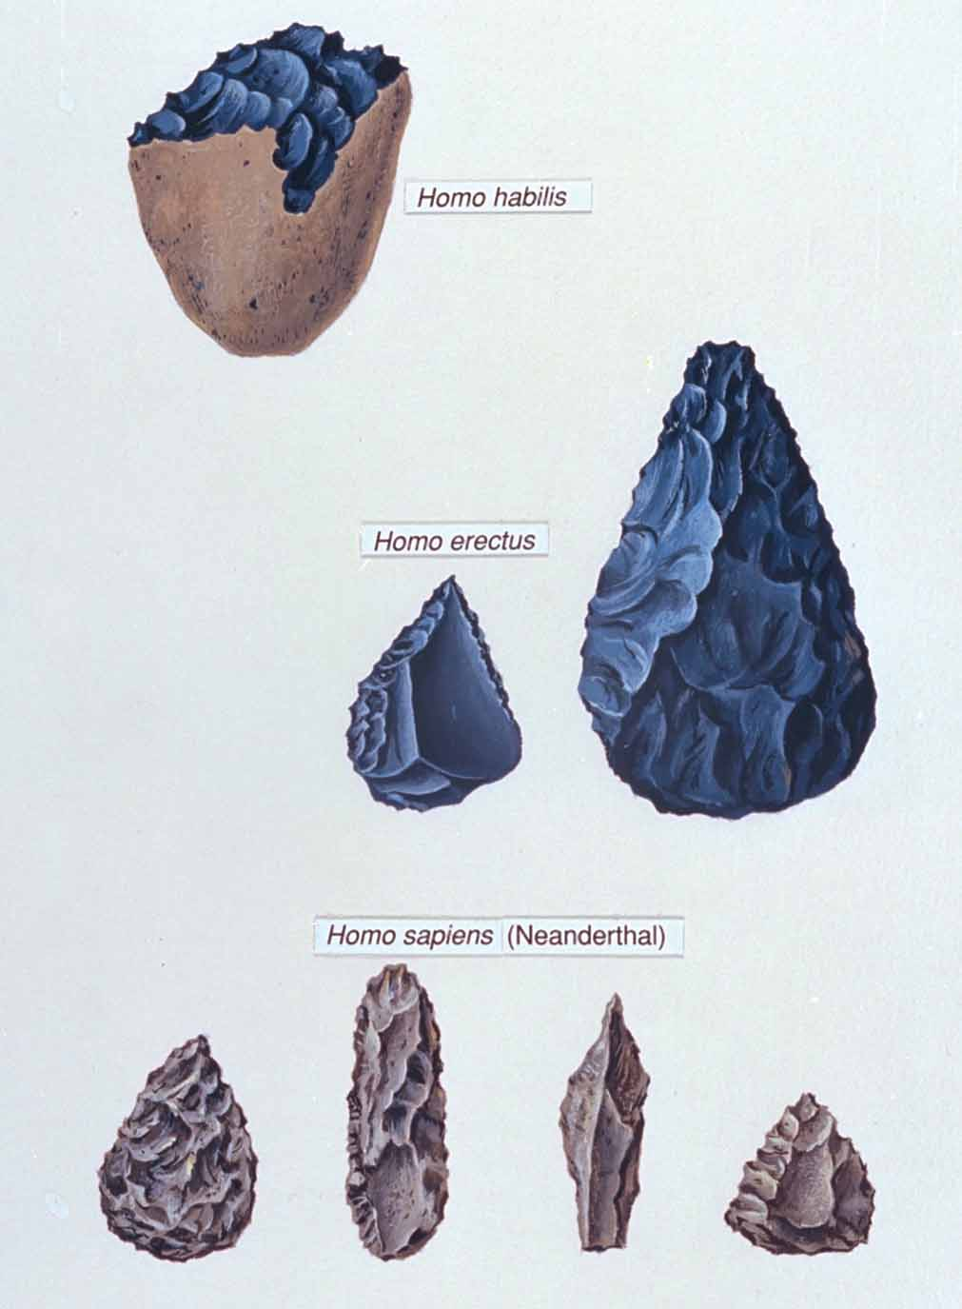
Early hominid tools.
What is cultural adaptation, and why was it important in hominid development?
Source: Howard S. Friedman/Pearson Education
Notes:
Early hominid tools.
What is cultural adaptation, and why was it important in hominid development?

Slide 7
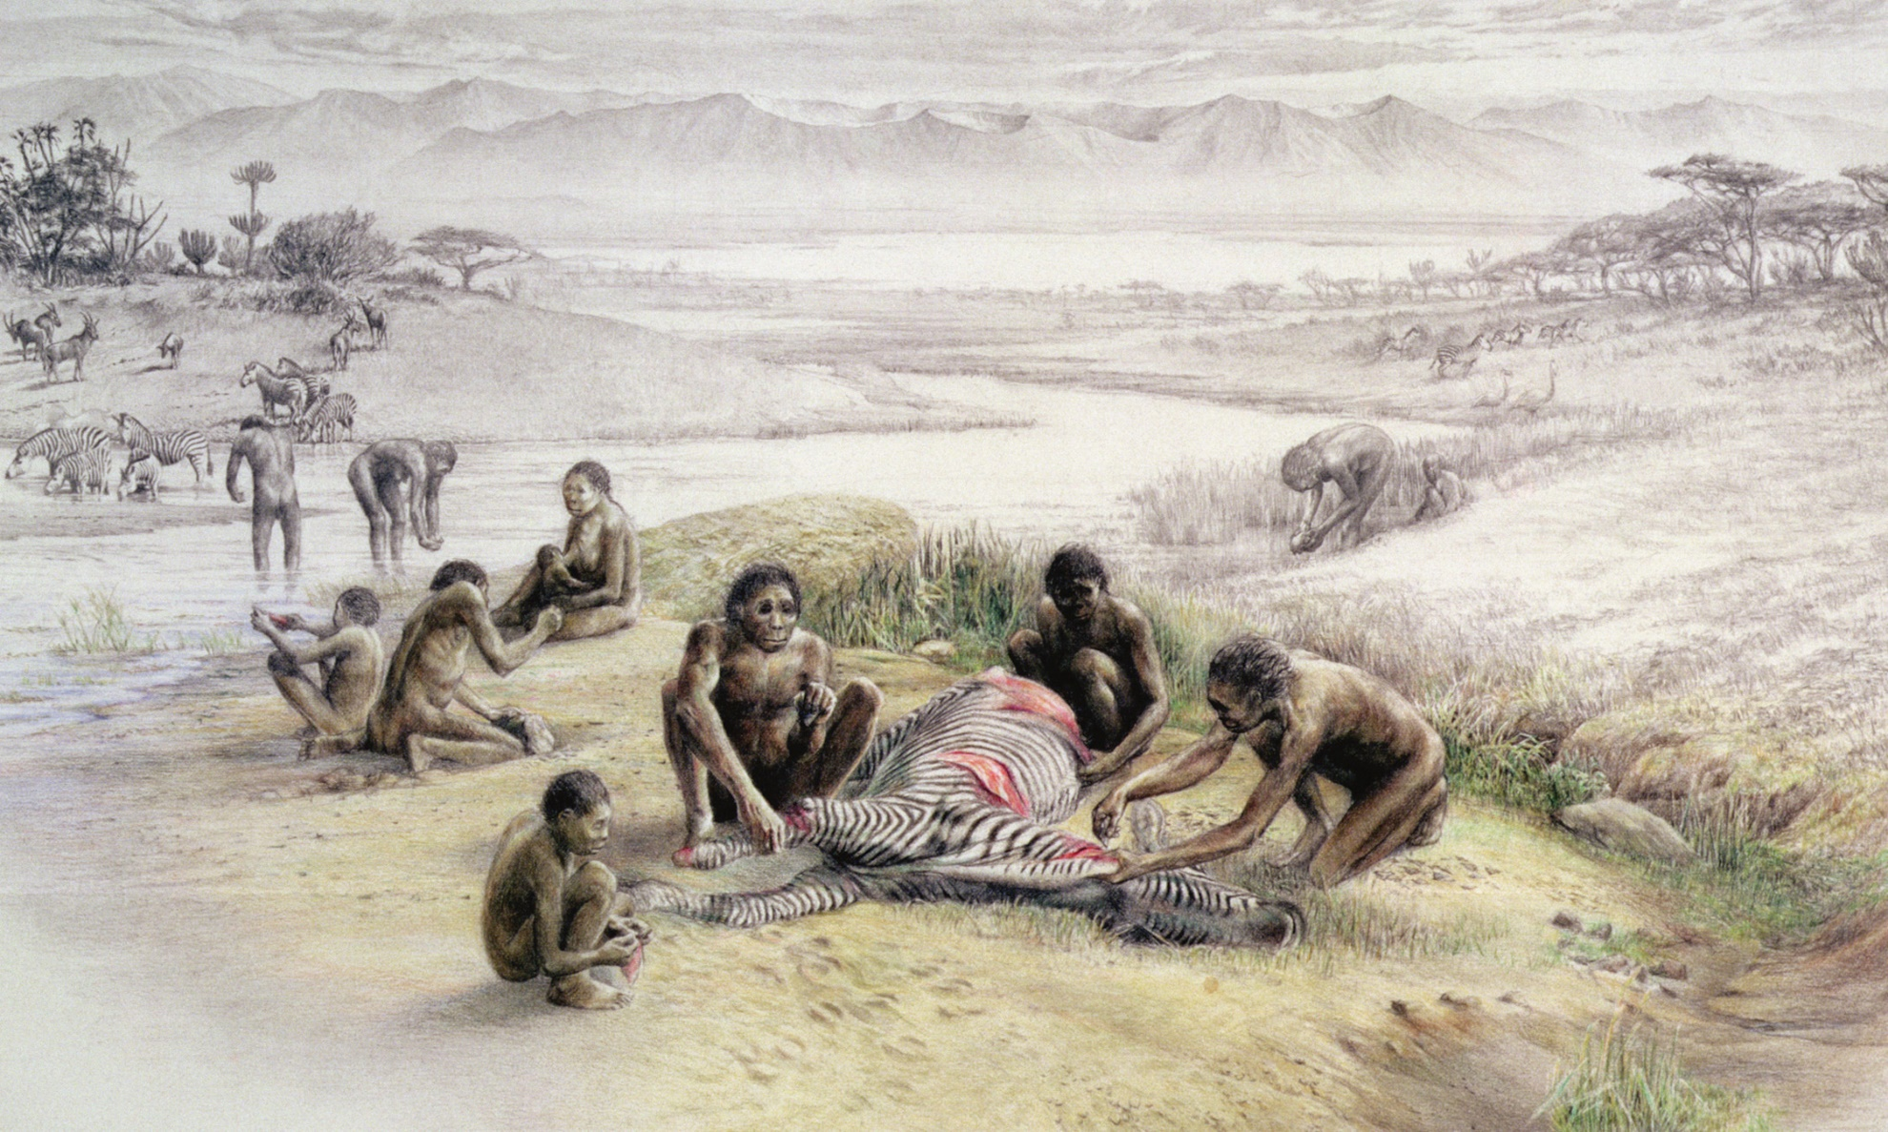
Depiction of hominid foragers.
Source: Visual Arts Library (London)/The Art Gallery Collection/Alamy
Notes:
Depiction of hominid foragers.
Source: Visual Arts Library (London)/The Art Gallery Collection/Alamy

Slide 8
Our Earliest Ancestors
Ice Age Migrations and Homo Sapiens
  Pleistocene, Great Ice Age (2 Million Years Ago to 8000 B.C.E.)
  Migration to Eurasia
  Hominids reached Asia by about 1.8 million years ago
  Evolution of Homo Sapiens
    Differed from early hominids -create more sophisticated tools
  The concept of race is best described as without scientific foundation
  the main cause of diversity among human populations response to different environments
Copyright © 2009 Pearson Education, Inc. Upper Saddle River, NJ 07458. All rights reserved.

Slide 9
  humans living in northern regions of the world They had lighter coloration and hairier bodies.
  Development of intellectual and linguistic skills
  Population growth
  Migration to Australia and Americas
  The first migration of humans around the globe was related to the food supply

Slide 10
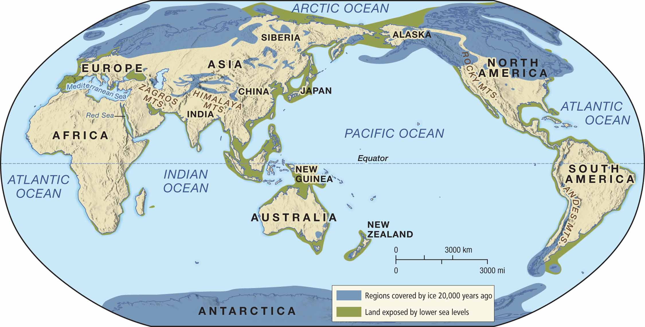
MAP 1.1 The Great Ice Age, 2,000,000–8000 B.C.E.
Notes:
MAP 1.1 The Great Ice Age, 2,000,000–8000 B.C.E.

Slide 11
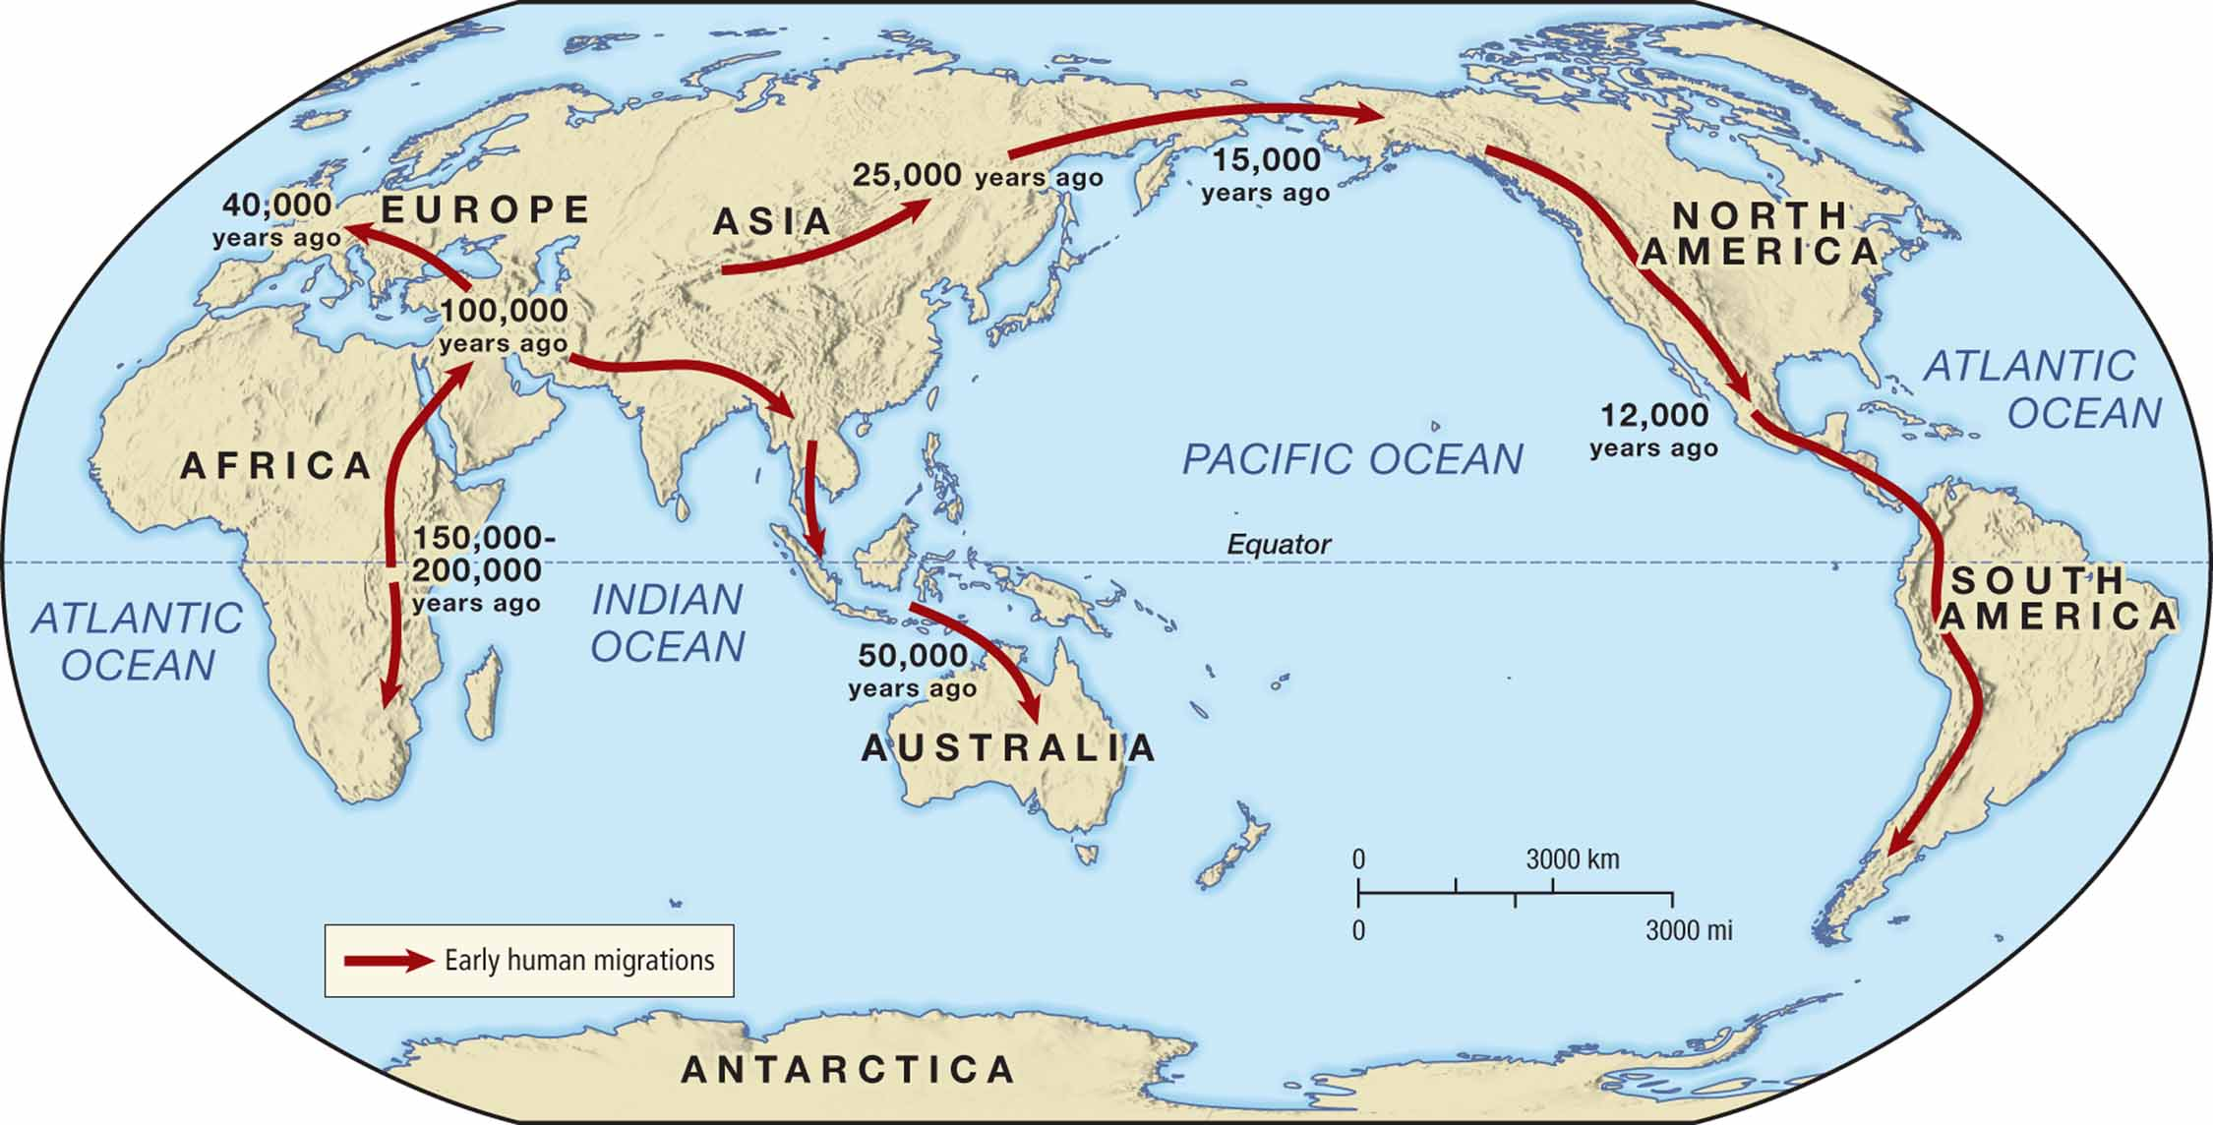
MAP 1.2 Humans Inhabit the Continents, 200,000–10,000 B.C.E.
Notes:
MAP 1.2 Humans Inhabit the Continents, 200,000–10,000 B.C.E.

Slide 12
Our Earliest Ancestors
Physical and Cultural Diversity
  A single species
    Neanderthals differ from hominids primarily in being associated with Europe
    The relationship of Neanderthals to Homo sapiens is a matter of debate
  The environment and cultural diversity
Paleolithic Cultural and Spiritual Perspectives
  Symbolic and artistic expression
  Rituals and religion
    Burial Practices
  The Paleolithic period lasted about 2 million years
Copyright © 2009 Pearson Education, Inc. Upper Saddle River, NJ 07458. All rights reserved.

Slide 13
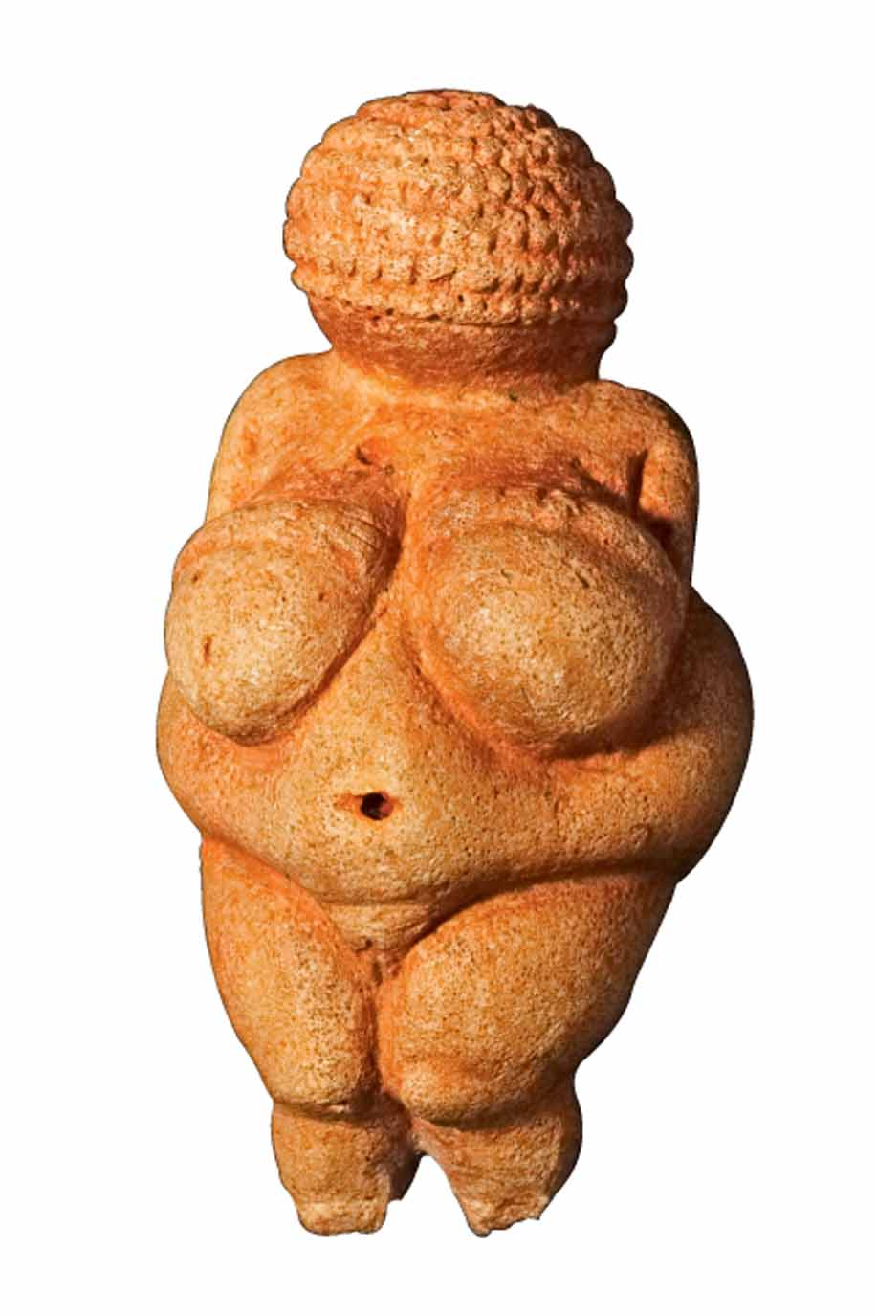
Venus figurine.
Source: Riedmiller/Caro/Alamy
Notes:
Venus figurine.
Source: Riedmiller/Caro/Alamy

Slide 14
The Origins and Impact of Agriculture
The Origins of Farming and Herding
The Neolithic period began around 10,000 B.C.E. and is the period during which humans began farming and herding.
  West Asian beginnings10,000 BCE
  Climate and settled agriculture
  Settlement, population, and productivity
  Animal husbandry
  new types of tools
Copyright © 2009 Pearson Education, Inc. Upper Saddle River, NJ 07458. All rights reserved.

Slide 15
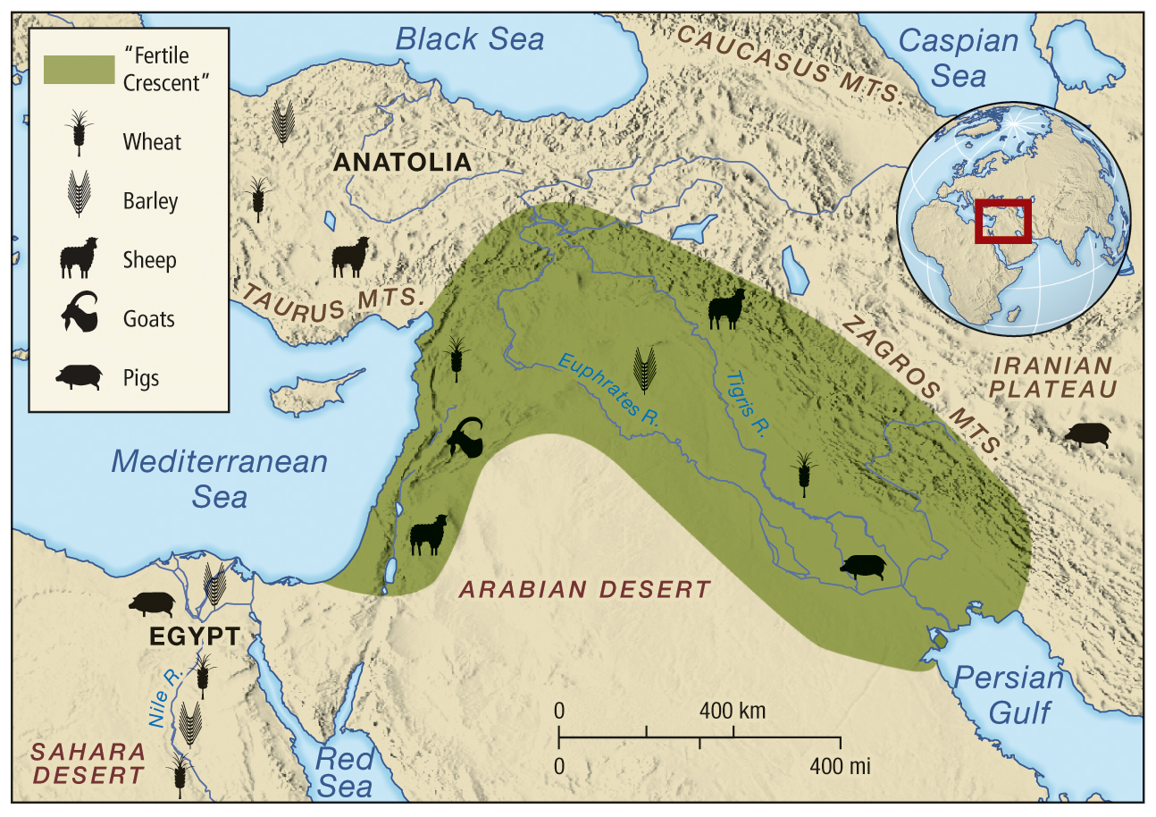
MAP 1.3 Agriculture Emerges in West Asia, 9000–8000 B.C.E.
Notes:
MAP 1.3 Agriculture Emerges in West Asia, 9000–8000 B.C.E.

Slide 16
The Origins and Impact of Agriculture
Agricultural Innovation and Expansion
  Agricultural diversity and dissemination
  Agricultural innovation
  Farming and population growth
  Farming originated independently in several areas.
  Farming is the defining characteristic of Neolithic culture
  The shift to farming is called a “revolution” because it brought profound changes
  Grains were common to all of the first agricultural systems
Copyright © 2009 Pearson Education, Inc. Upper Saddle River, NJ 07458. All rights reserved.

Slide 17
The influence of West Asia on farming over a large area of Asia, Europe, and Africa is seen in the cultivation of wheat and barley

Slide 18
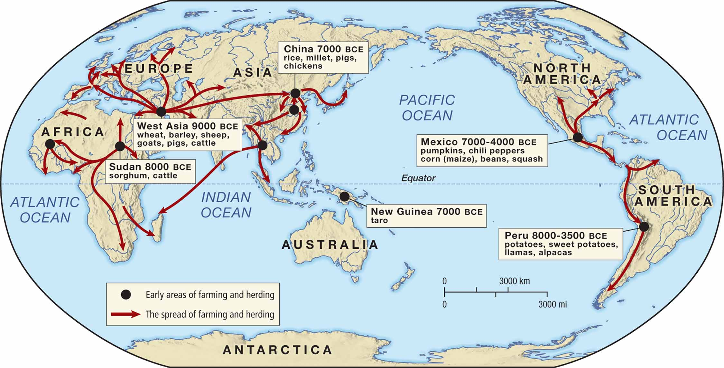
MAP 1.4 Agriculture Develops and Spreads, 9000 B.C.E.–1000 C.E.
Notes:
MAP 1.4 Agriculture Develops and Spreads, 9000 B.C.E. – 1000 C.E.

Slide 19
The Origins and Impact of Agriculture
Agricultural Society: Village, Family, and Land
  Village life
    generally surrounded by farmland
  Growth and social complexity
  Farming, family, and gender
    tending livestock was a common woman’s role in pastoral societies
    Society based on the family
    patriarchal societies
Copyright © 2009 Pearson Education, Inc. Upper Saddle River, NJ 07458. All rights reserved.

Slide 20
The Impact of Agriculture
  The disadvantages of farming
  Surpluses
  The slash-and-burn technique benefited farmers only
  Squash was grown in Mexico from about 4000 B.C.E

Slide 21
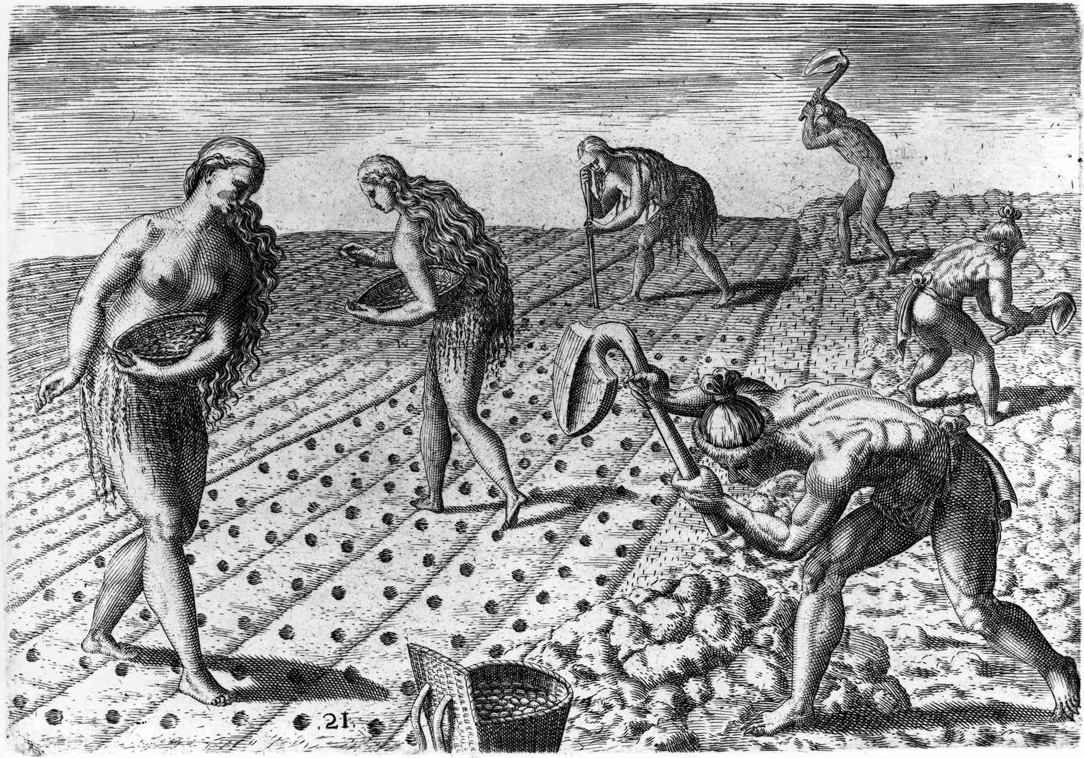
Women and men doing farm work in the Americas.
Source: Library of Congress, Prints & Photographs Division, [LC-DIG-ppmsca-02937]
Notes:
Women and men doing farm work in the Americas.
Source: Library of Congress, Prints & Photographs Division, [LC-DIG-ppmsca-02937]

Slide 22
The Emergence of Complex Societies
Towns, Cities, Occupations, and Religion
  Two Regions: Tigris and Euphrates valleys, Nile River
  Towns first emerged in the late Neolithic period
  Surplus food and urbanization
    agricultural surplus was a prerequisite to the development of large complex societies
    increased food supplies from farming permitted the development of specialized occupations in towns
    Çatal Hüyük was settled by 7000 B.C.E., and found in modern Turkey
  Economic specialization
  The growth of organized religion
  Political elites
Copyright © 2009 Pearson Education, Inc. Upper Saddle River, NJ 07458. All rights reserved.

Slide 23
The Emergence of Complex Societies
States and Civilizations
  Political centralization
  The power of cities
  States: a territory under a central government0
  All of the earliest states arose near rivers
  In West Asia, civilization first began along the Tigris and Euphrates rivers
  Çatal Hüyük was settled by 7000 B.C.E., and found in modern Turkey
  Like Çatal Hüyük, Ur and Uruk were among the world’s first cities
Copyright © 2009 Pearson Education, Inc. Upper Saddle River, NJ 07458. All rights reserved.

Slide 24
In the first towns, religion became more organized
In Egypt, the first states probably emerged around 4000 BCE

Slide 25
The advent of agriculture was a fundamental shift in human social development. The formation of permanent settlements led to the creation of ever more complex communities. As these settlements grew, social and economic specialization emerged along with political centralization.
It is not too much to say that agriculture was the necessary precondition for the development of civilization. The rise of agriculture did not put an end to nomadic societies. However, henceforth, human history would be dominated by complex, regional societies and the connections and conflicts between them.

Slide 26
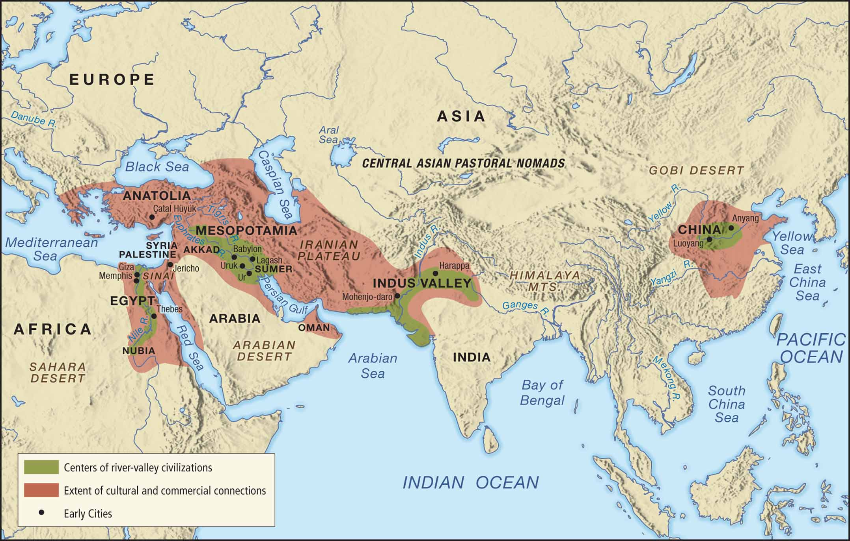
MAP 1.5 Early States and Civilizations Emerge in River Valleys, 4000–2000 B.C.E.
Notes:
MAP 1.5 Early States and Civilizations Emerge in River Valleys, 4000–2000 B.C.E.

Slide 27
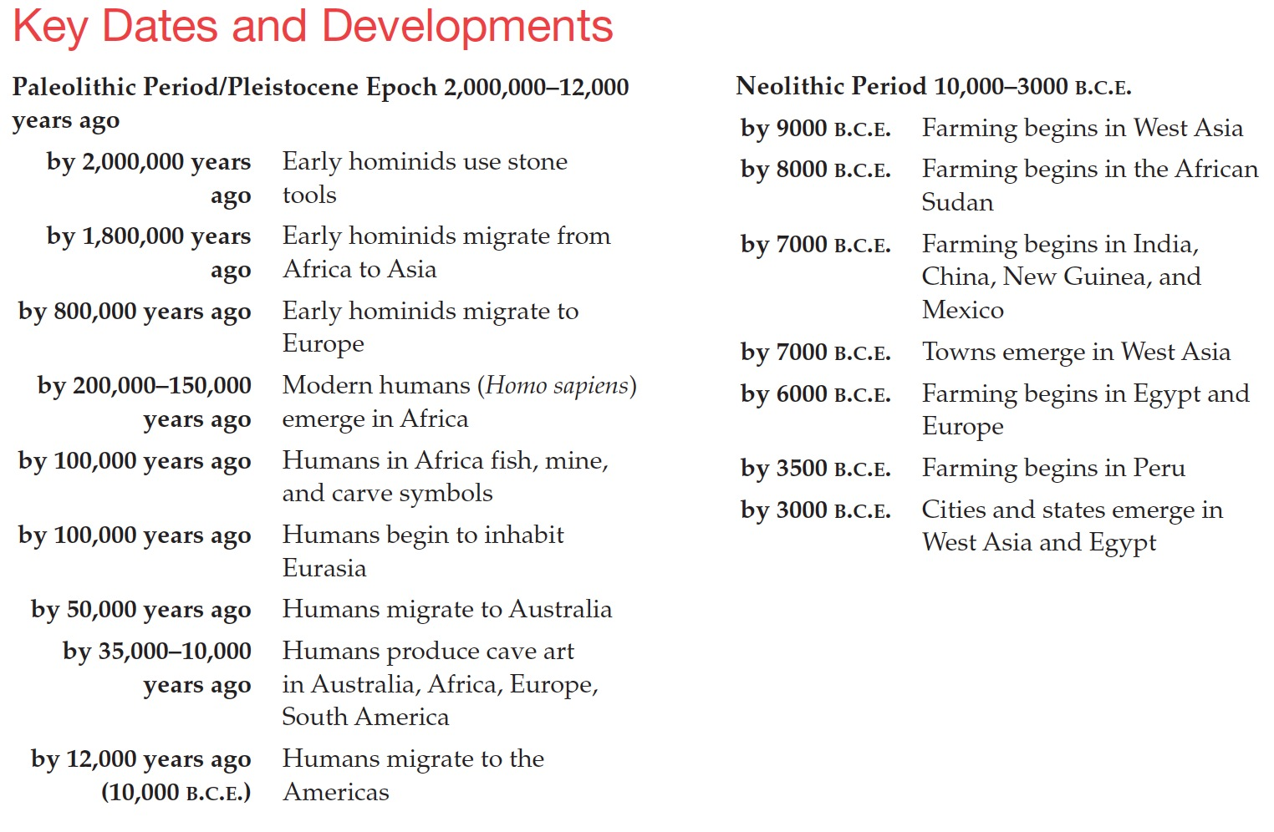
Key Dates and Developments
Paleolithic Period/Pleistocene Epoch Neolithic Period 2,000,000–12,000 years ago
Notes:
Key Dates and Developments
Paleolithic Period/Pleistocene Epoch Neolithic Period 2,000,000–12,000 years ago

