Slide 1
MAFB Heritage
A Brief History of Maxwell/Gunter AFB
Dr. Silvano Wueschner
AU Office of History

Slide 2
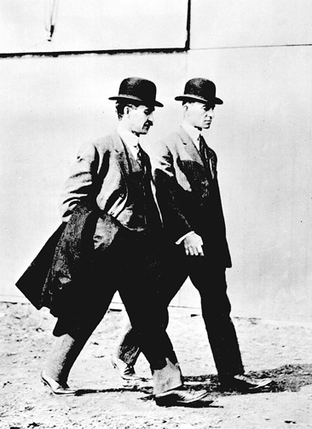
MAFB Heritage, Cont’d
In late February 1910,
two brothers came to
Montgomery. They
wanted to open a
school…

Slide 3
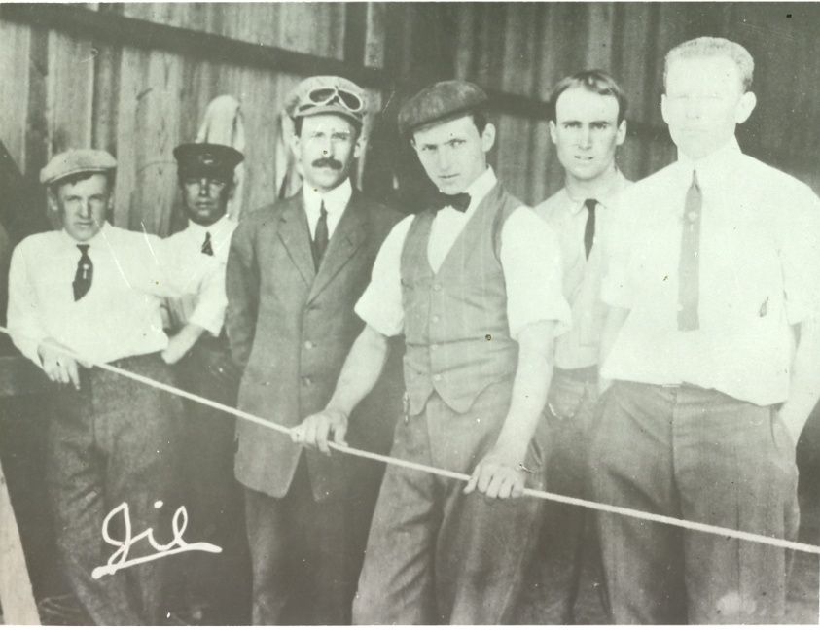
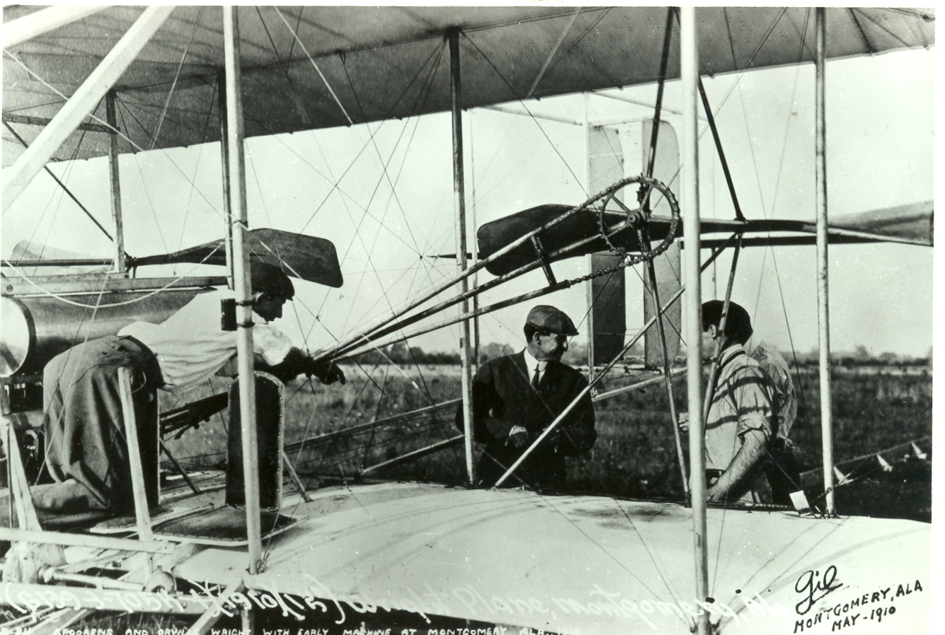
MAFB Heritage, Cont’d
The Wright Flying School was
The 1st of its kind in the U.S.
And Montgomery
land owners and merchants made
that possible…

Slide 4
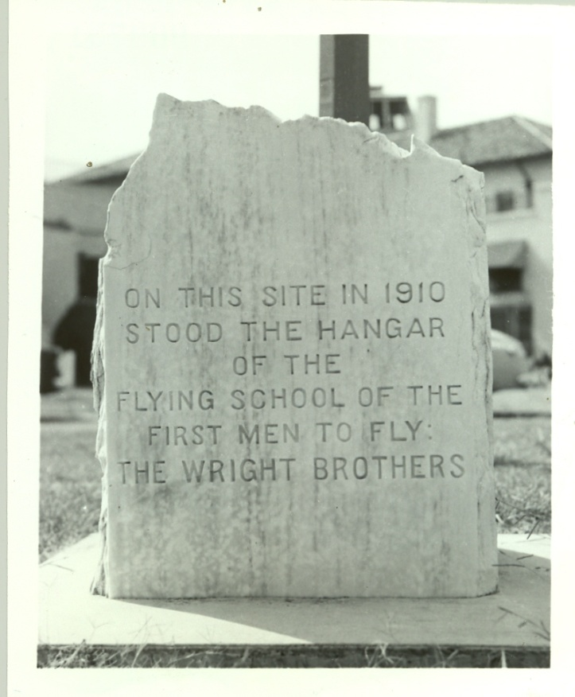
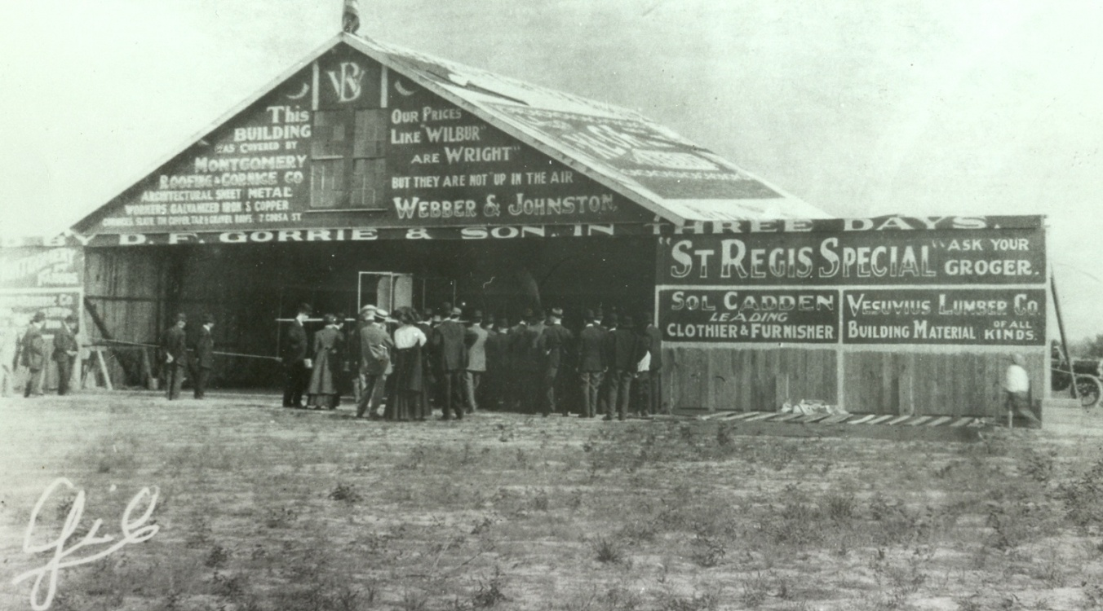
MAFB Heritage, Cont’d
Montgomerians donated the land, built a hangar,
and then extended the city’s trolley line to reach the
school – today it’s the site of the Maxwell Ops Bldg.

Slide 5
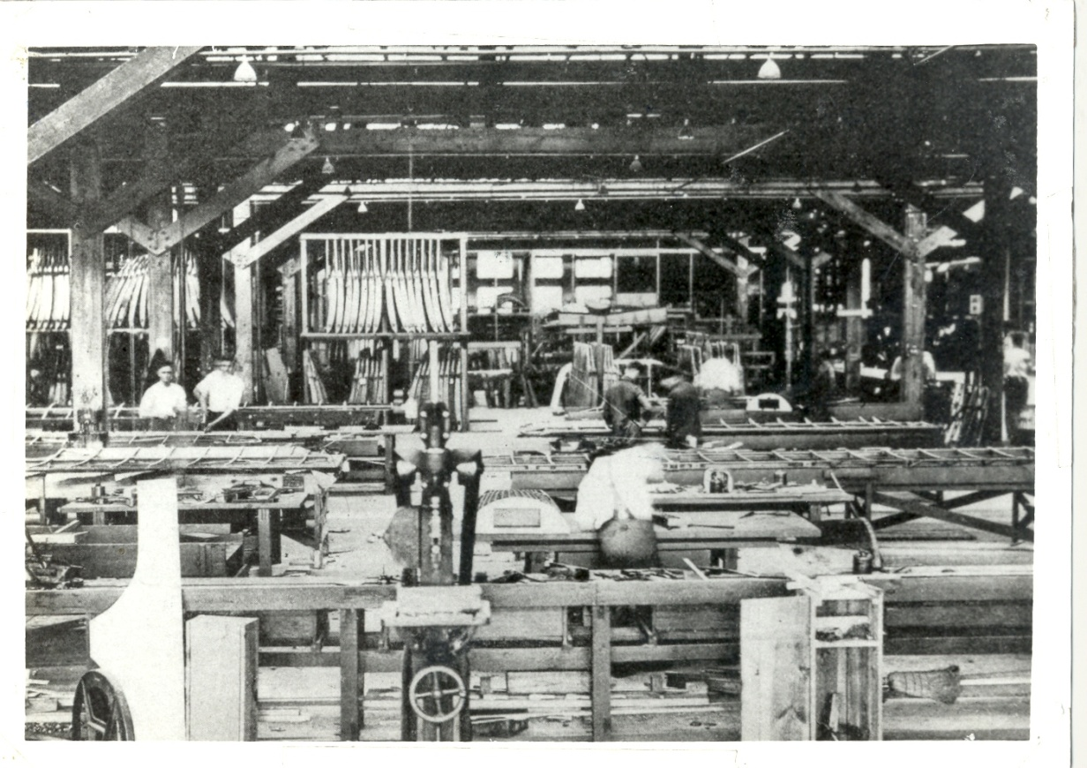
MAFB Heritage, Cont’d
During World War I, the former Wright Flying Field
became ‘Aircraft and Engine Repair Depot No. 3’.
It supported six
training airfields
in the Southeastern
U.S., including
Taylor Field, near
today’s Pike Road.

Slide 6
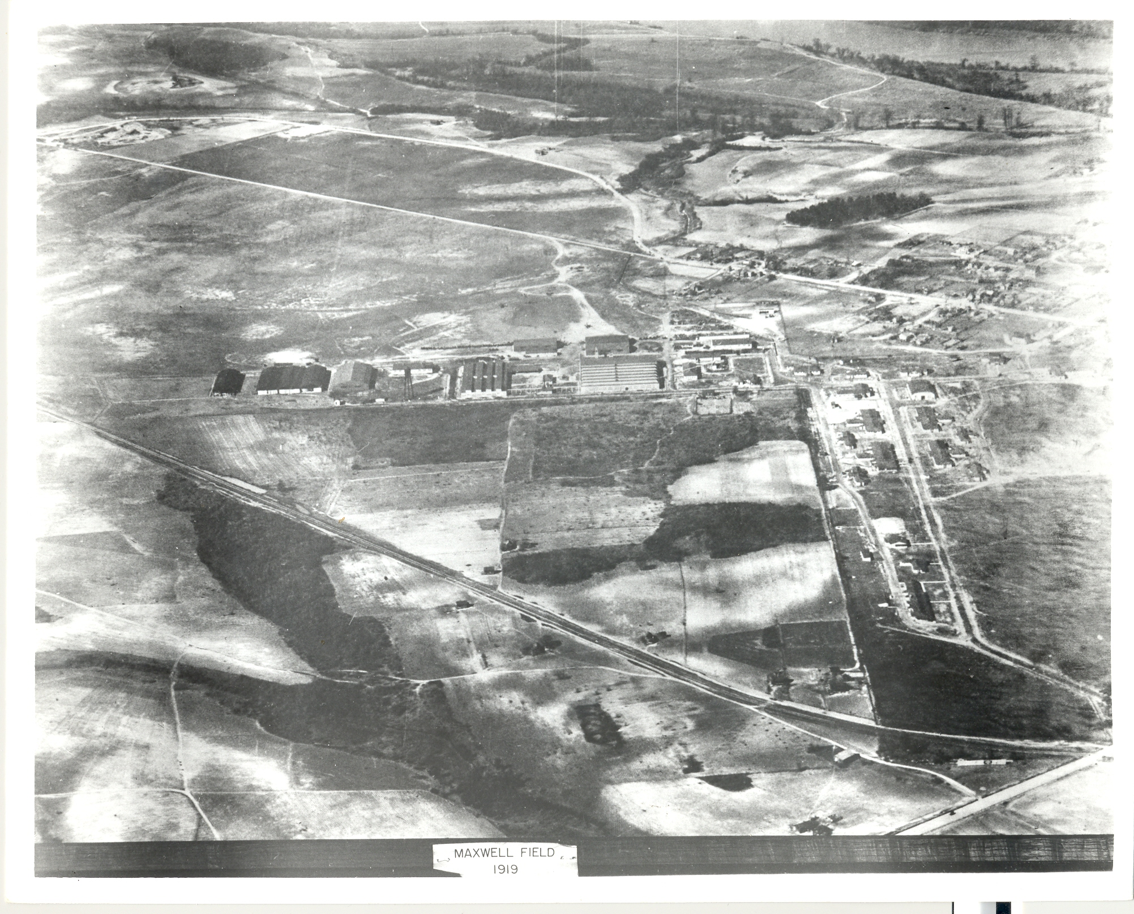
MAFB Heritage, Cont’d
Aircraft Repair Depot Montgomery, 1919

Slide 7
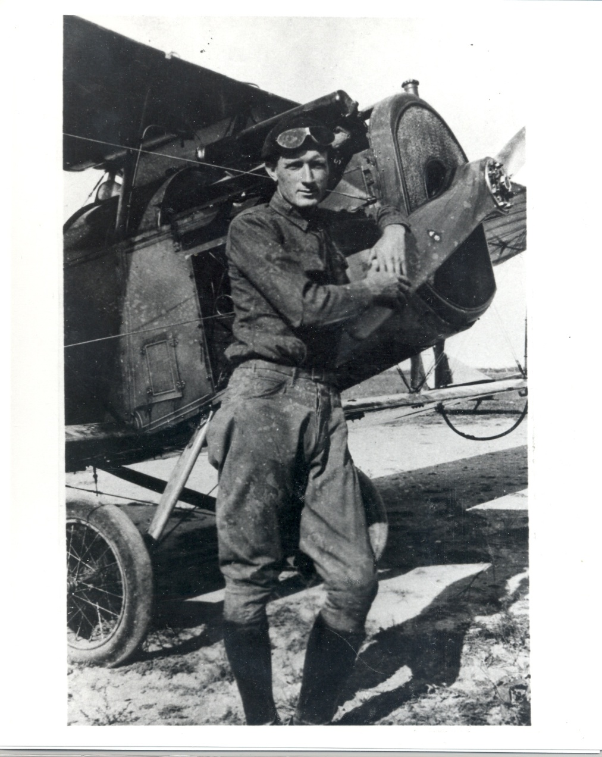
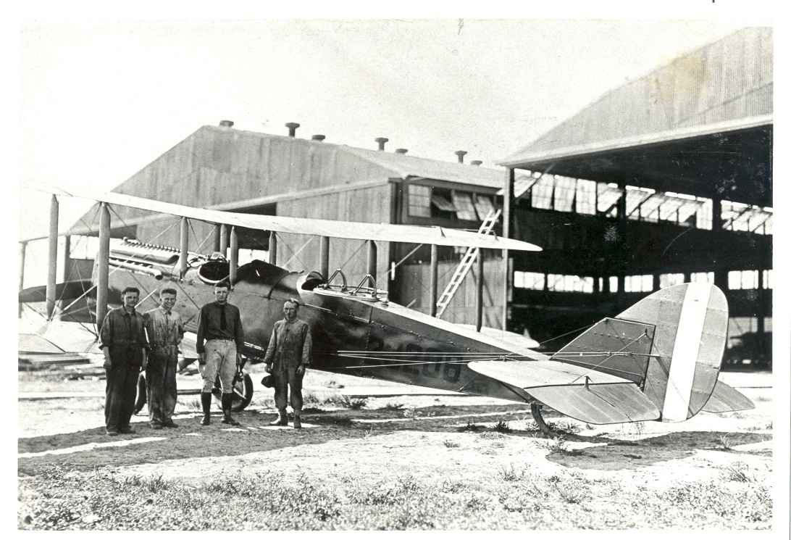
MAFB Heritage, Cont’d
The facility was named
Maxwell Field in 1922 in
honor of 2Lt. William C.
Maxwell (1892-1920).

Slide 8
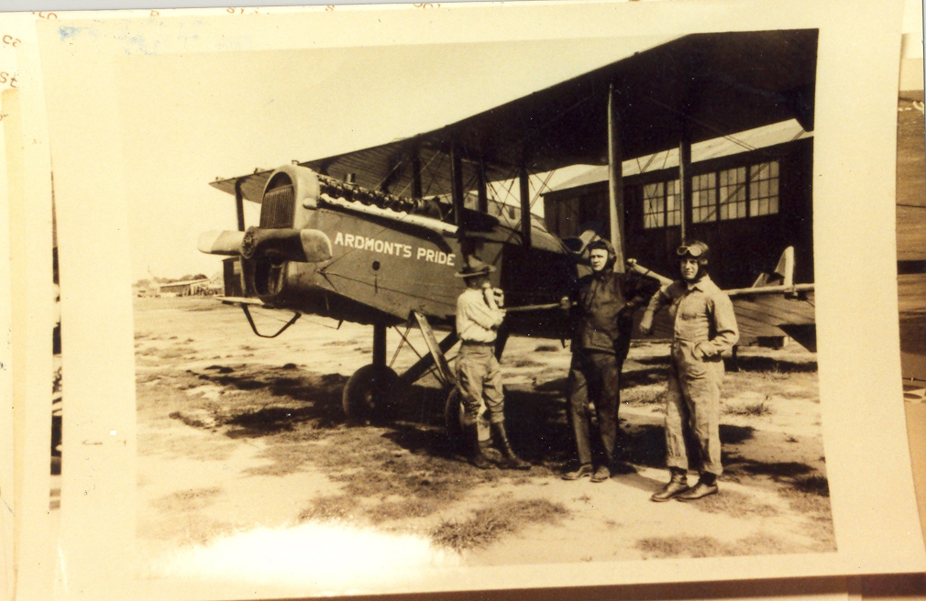
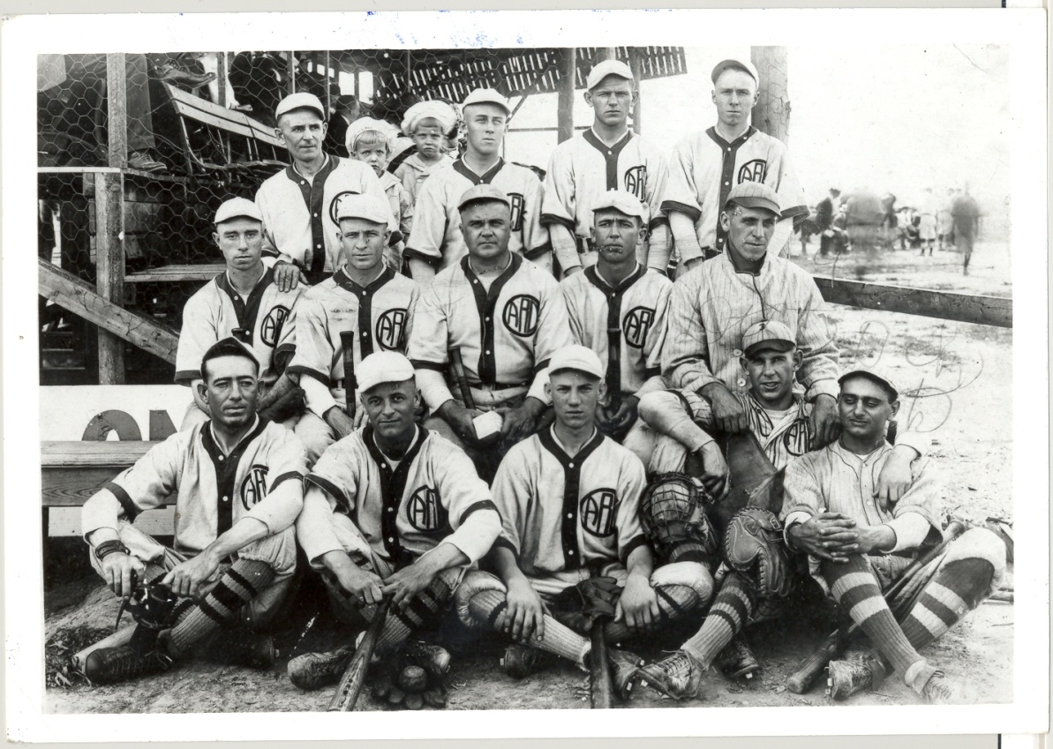
MAFB Heritage, Cont’d
Work hard, play hard…

Slide 9
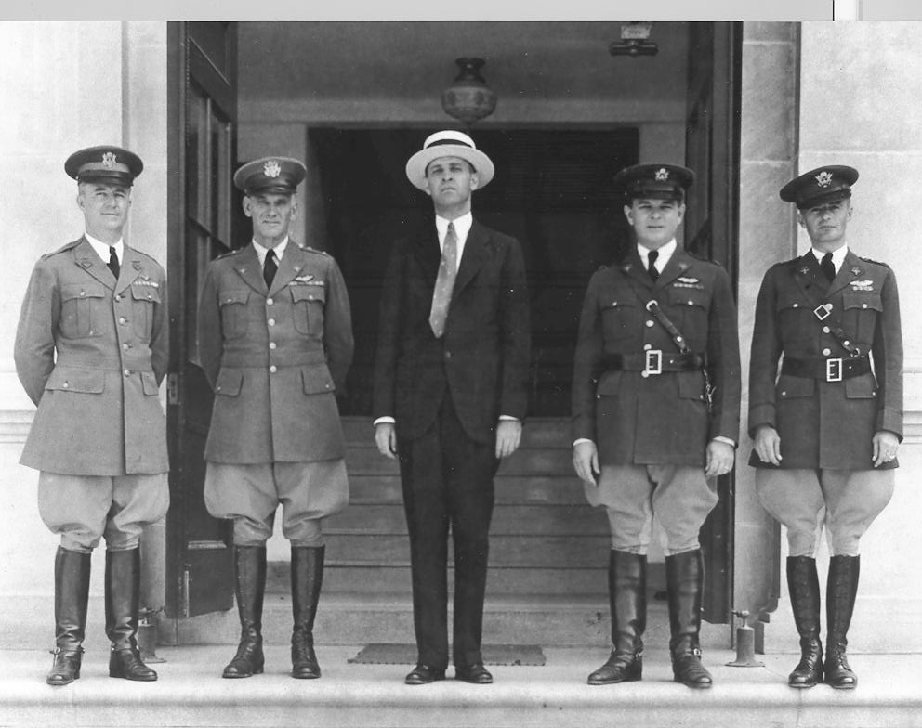
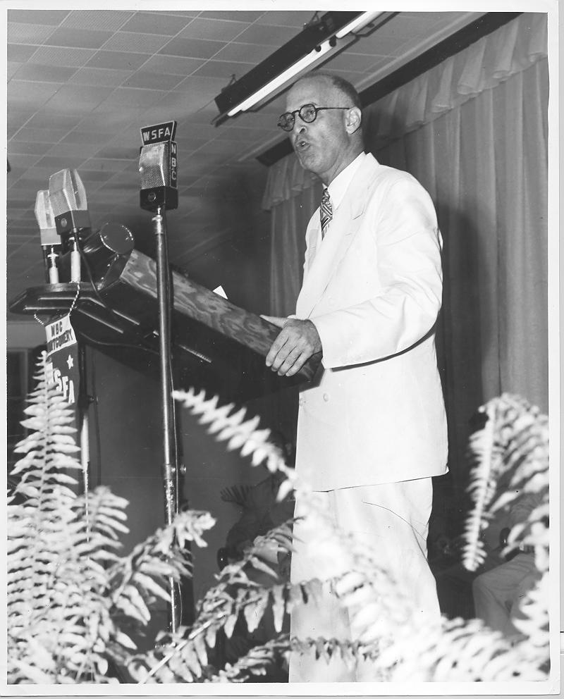
MAFB Heritage, Cont’d
J. Lister Hill (1894-1984)
“Godfather” of Maxwell
U.S. Rep., 2nd Dist, 1923-1938
U.S. Sen., 1938-1969

Slide 10
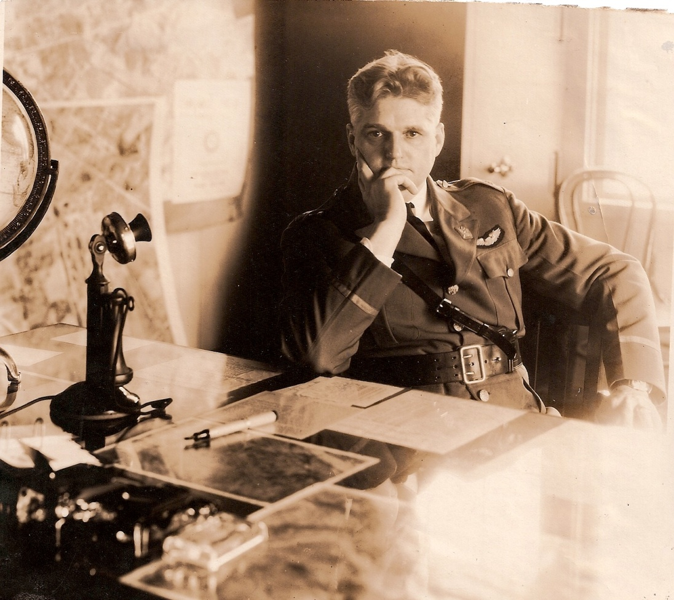
MAFB Heritage, Cont’d
Major Walter R. Weaver, USAAC Maxwell Field Post Commander,
1927-1931

Slide 11
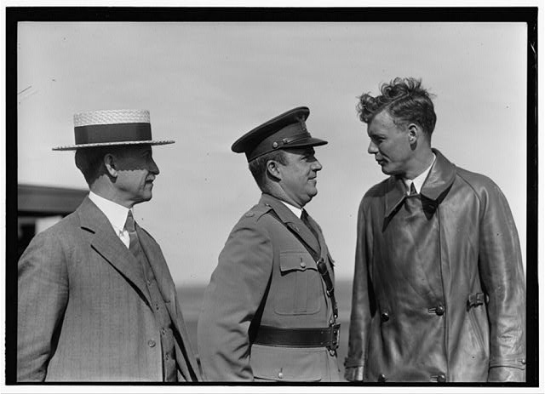
MAFB Heritage, Cont’d
Major John F. Curry, USAAC
Maxwell Field Post Commander,
1931-1935

Slide 12
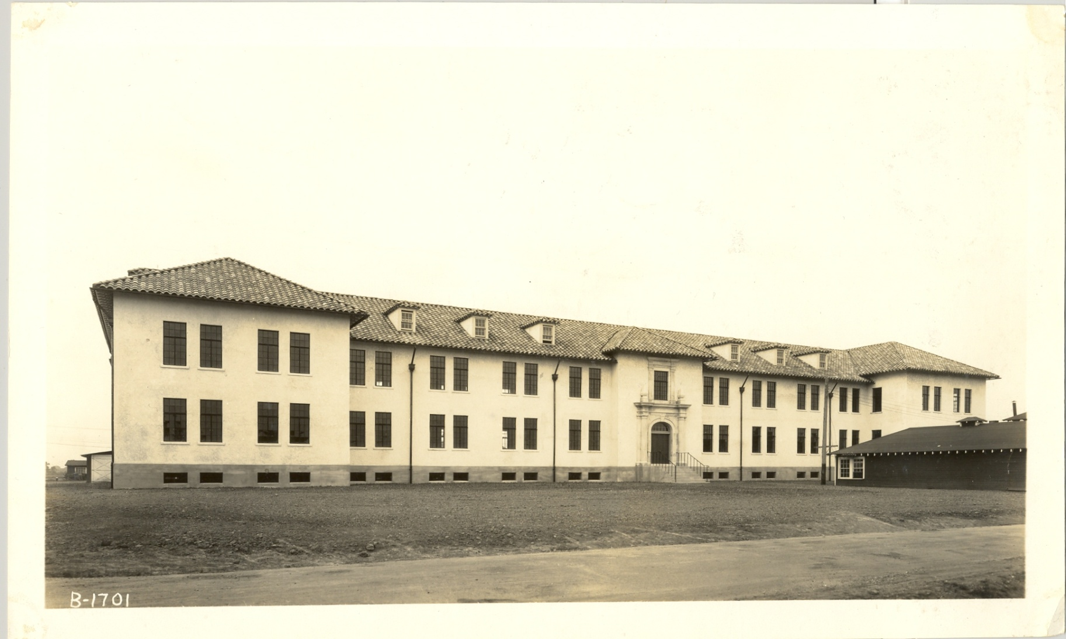
Bldg 836 – Oldest remaining bldg

Slide 13

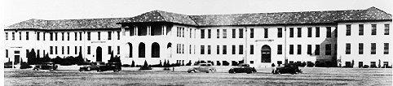
MAFB Heritage, Cont’d
In 1931, the Air Corps Tactical School moved
to Maxwell Field, and its influence on U. S.
air doctrine was profound…

Slide 14
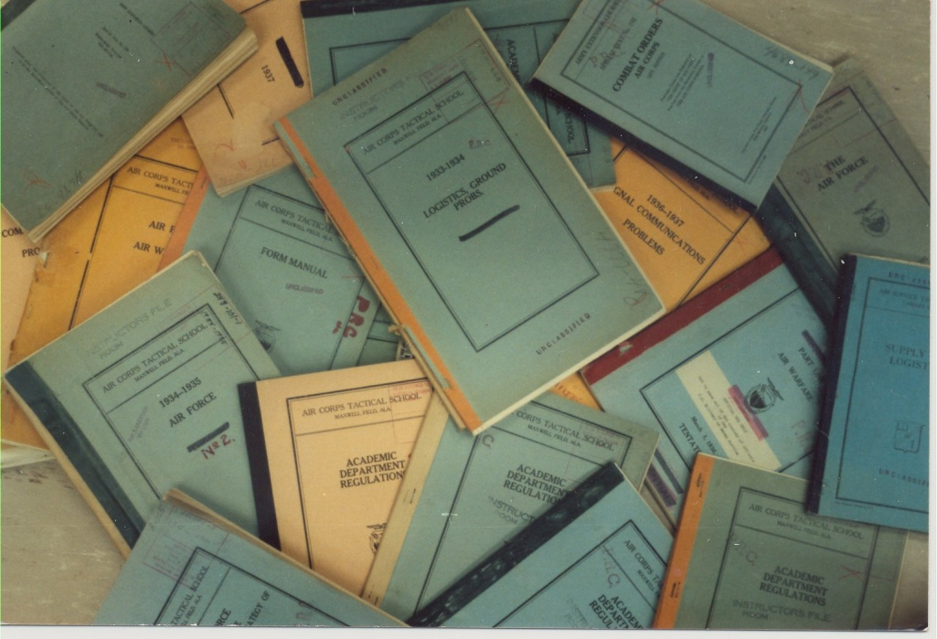
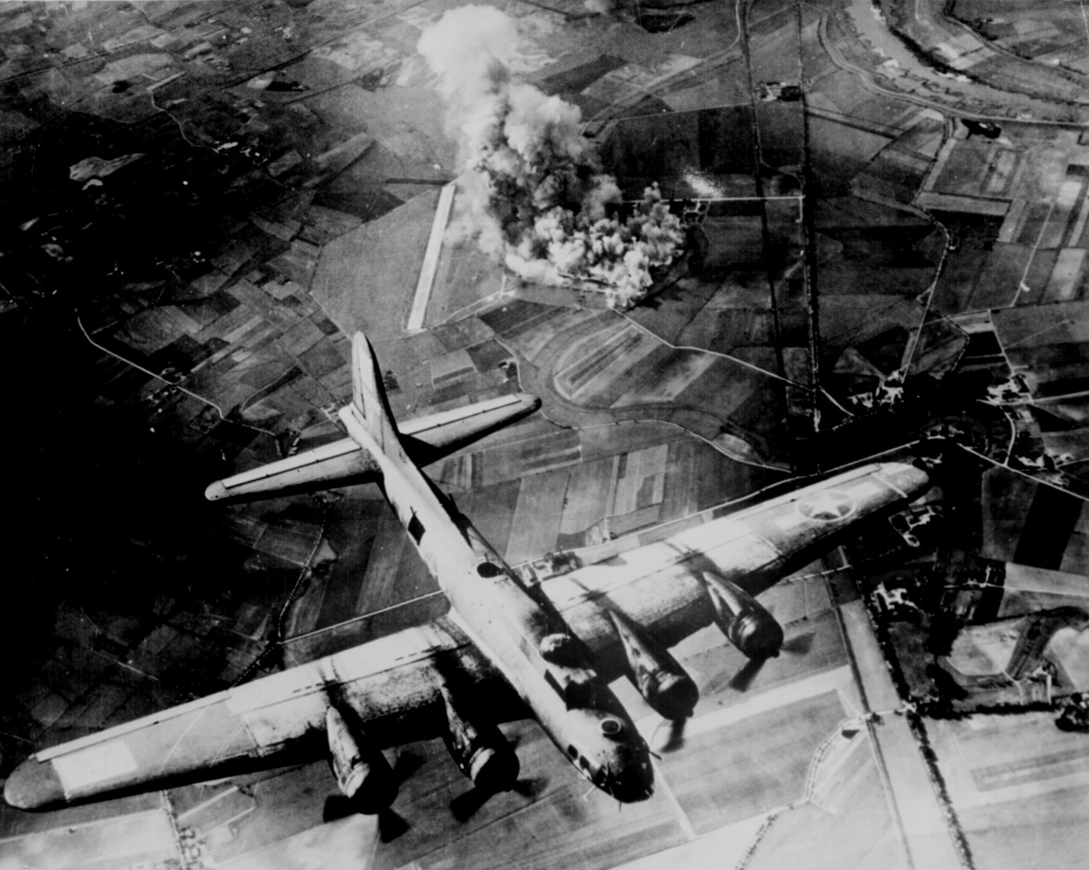
MAFB Heritage, Cont’d
The “Industrial Fabric” Theory
of Precision Daylight
Bombardment by Air…
…and its advocacy.
At War’s end, 260 of 321 USAAF GOs were ACTS grads.

Slide 15
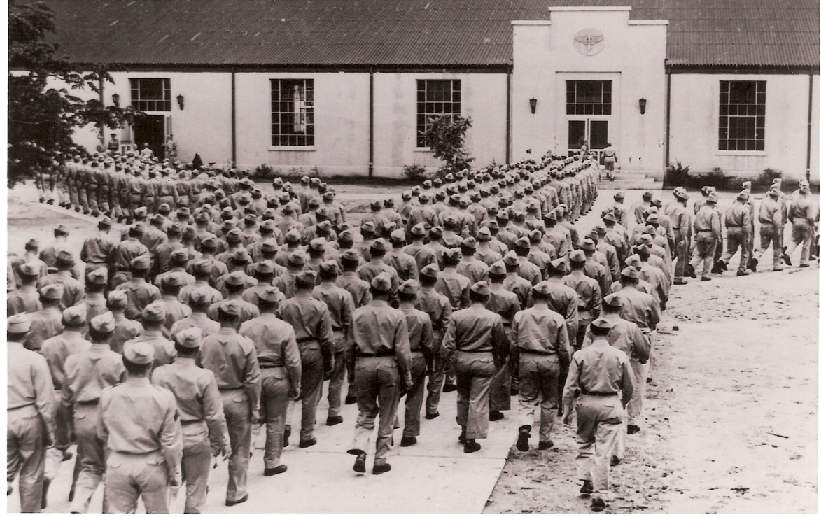
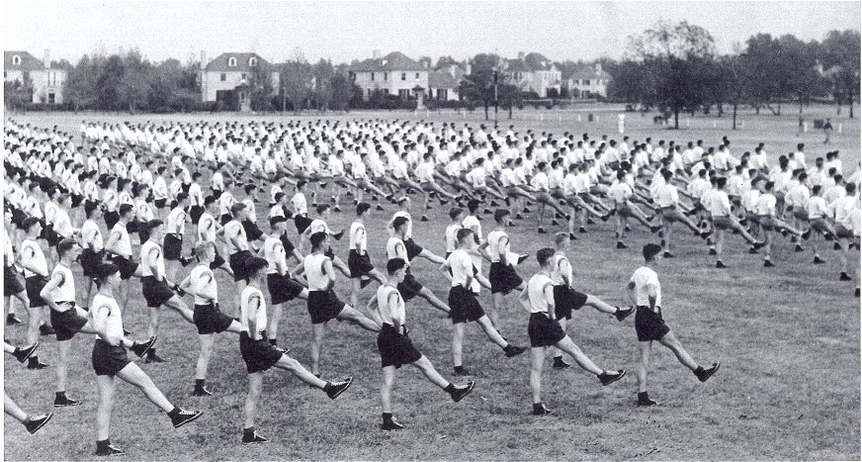
MAFB Heritage, Cont’d
With the war looming in Europe, the U.S. began
to prepare for war. The ACTS’ last class left in
1940, and Maxwell Field was greatly expanded to
become a major aircrew training base.

Slide 16
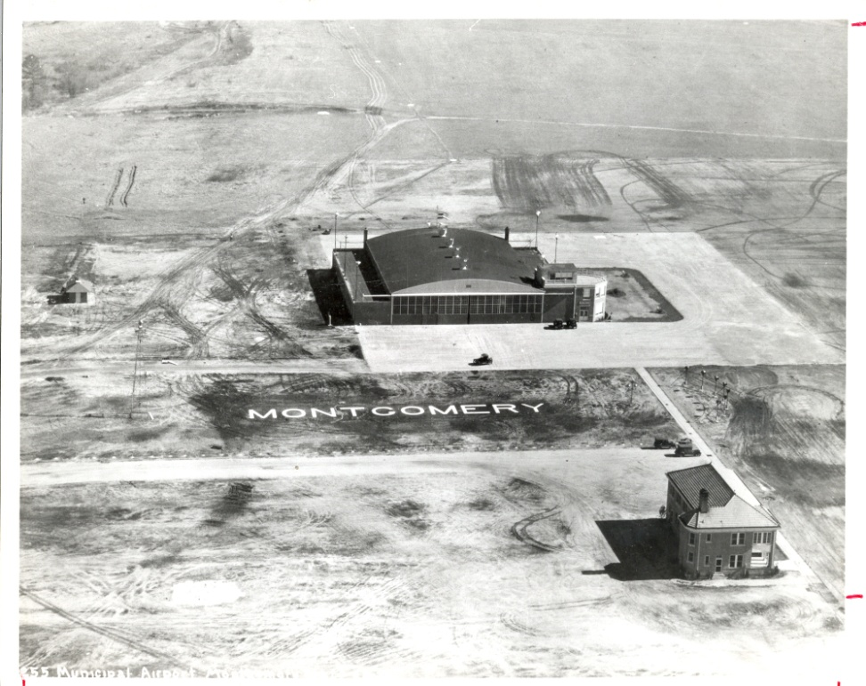
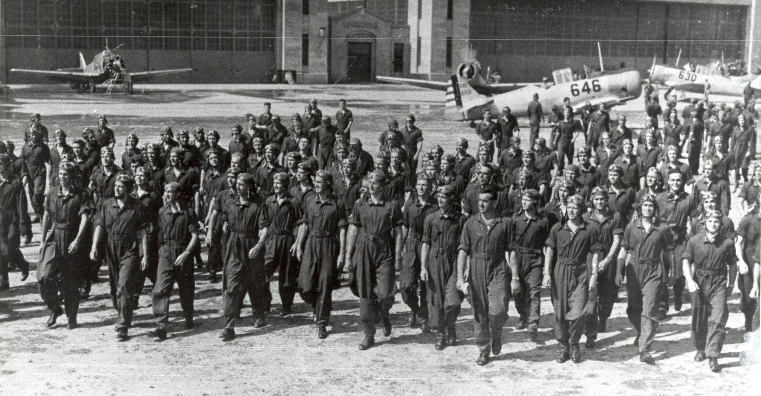

MAFB Heritage, Cont’d
Such was the need that Montgomery’s municipal
airport was also converted to an AAF training base
and renamed Gunter Field for Montgomery’s
recently deceased mayor, William A. Gunter.

Slide 17
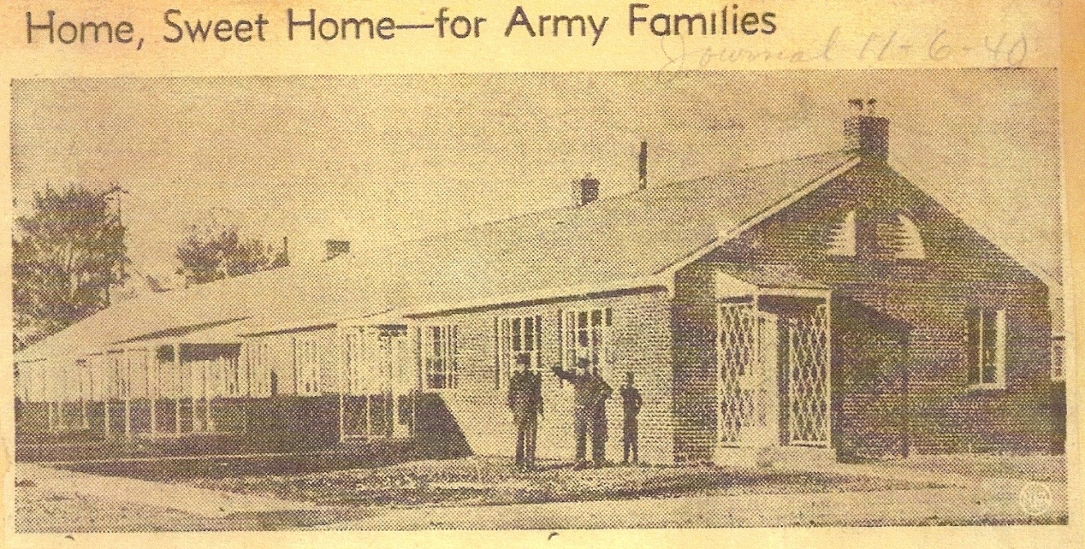
MAFB Heritage, Cont’d
Maxwell’s expansion put great strain on its
housing supply, leading the City of Montgomery
to borrow $1.5 million for an addition to Riverside
Heights…the first off-base housing project in the
U.S. specifically built by the Federal Government for enlisted families.
- 424 units in 85 Bldgs
- Completed in 119 days
- Opened on 1 Nov 1940
Avg initial rent: $18.86
per month (w/utilities)

Slide 18
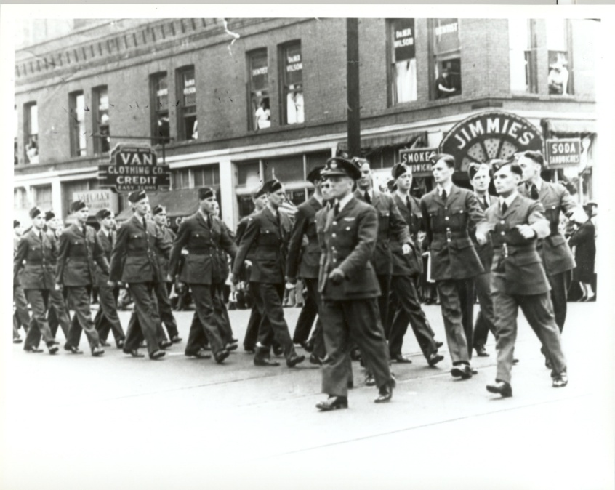
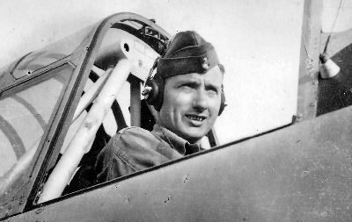

MAFB Heritage, Cont’d
In addition to training AAF aircrew and technicians,
the two bases also trained thousands of airmen
from the British Commonwealth, Free French and
Nationalist Chinese air forces.

Slide 19

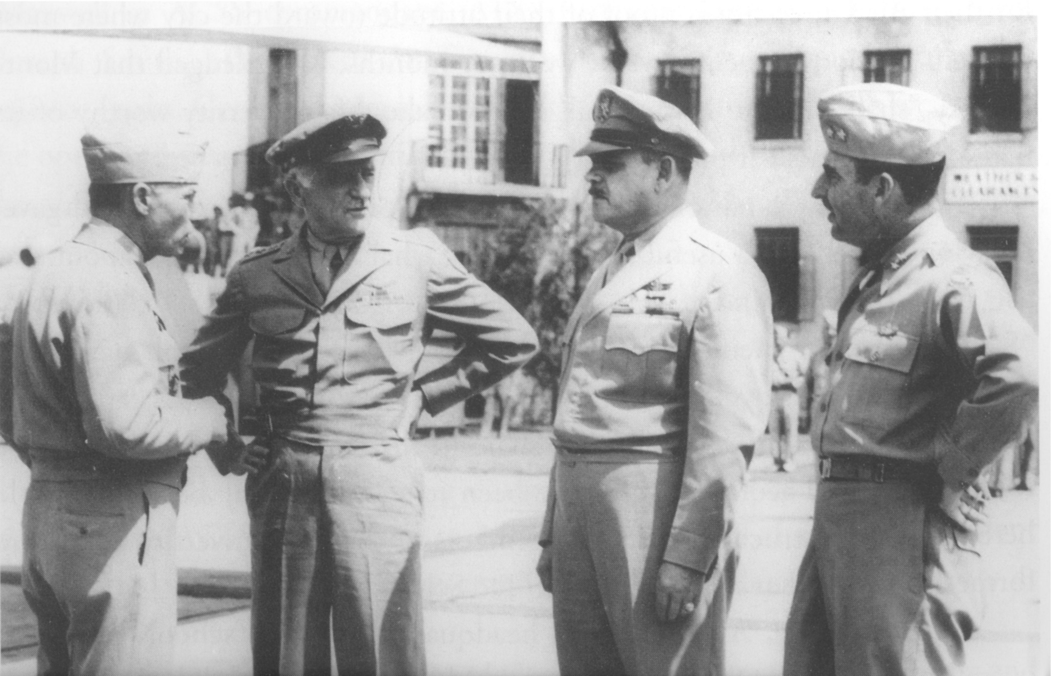
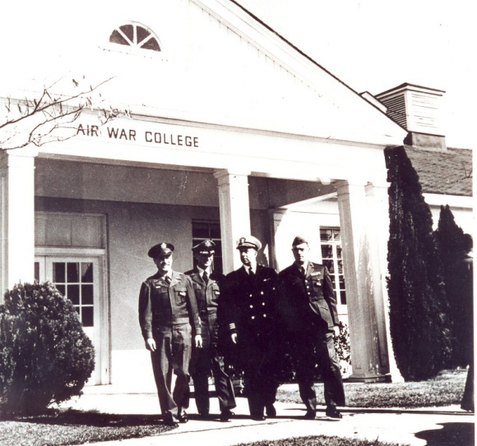
MAFB Heritage, Cont’d
With the restoration of peace, Maxwell faced an
uncertain future…until the arrival of the AAF
School in November 1945, and its reorganization
as Air University in February 1946.

Slide 20
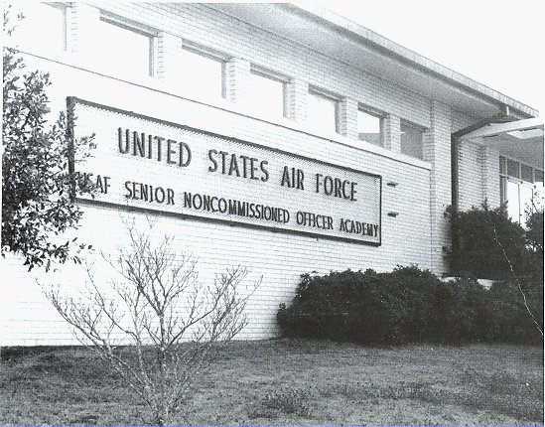
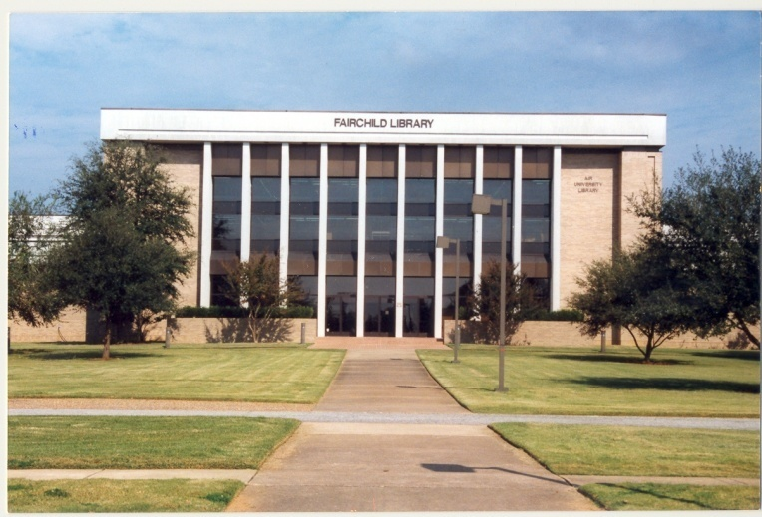

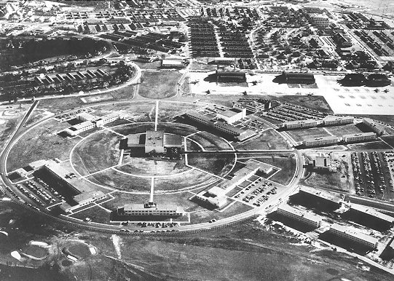
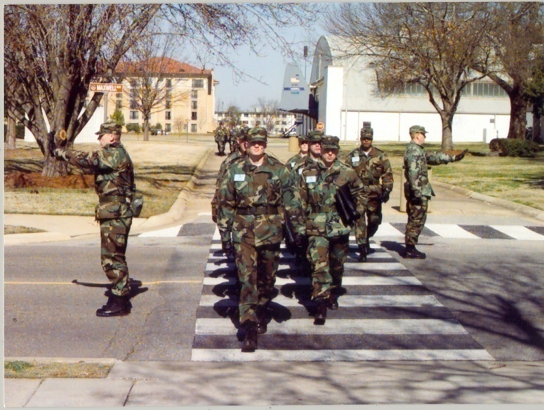
MAFB Heritage, Cont’d
Over the last 60 years, Maxwell-Gunter has expanded and evolved.

Slide 21
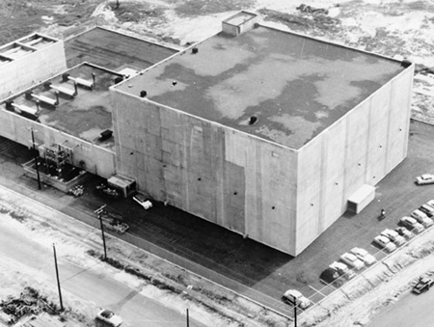




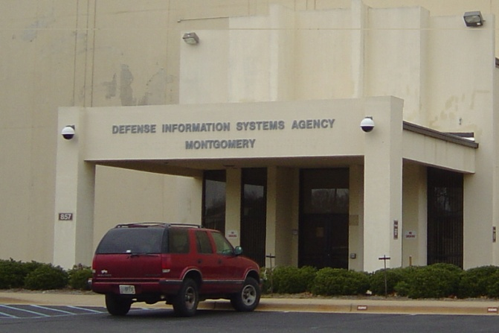
MAFB Heritage, Cont’d
Becoming an Air
Defense Sector
Center in the 1960s
gave Gunter AFB a
big lead in what has
since become The
Digital Age

Slide 22
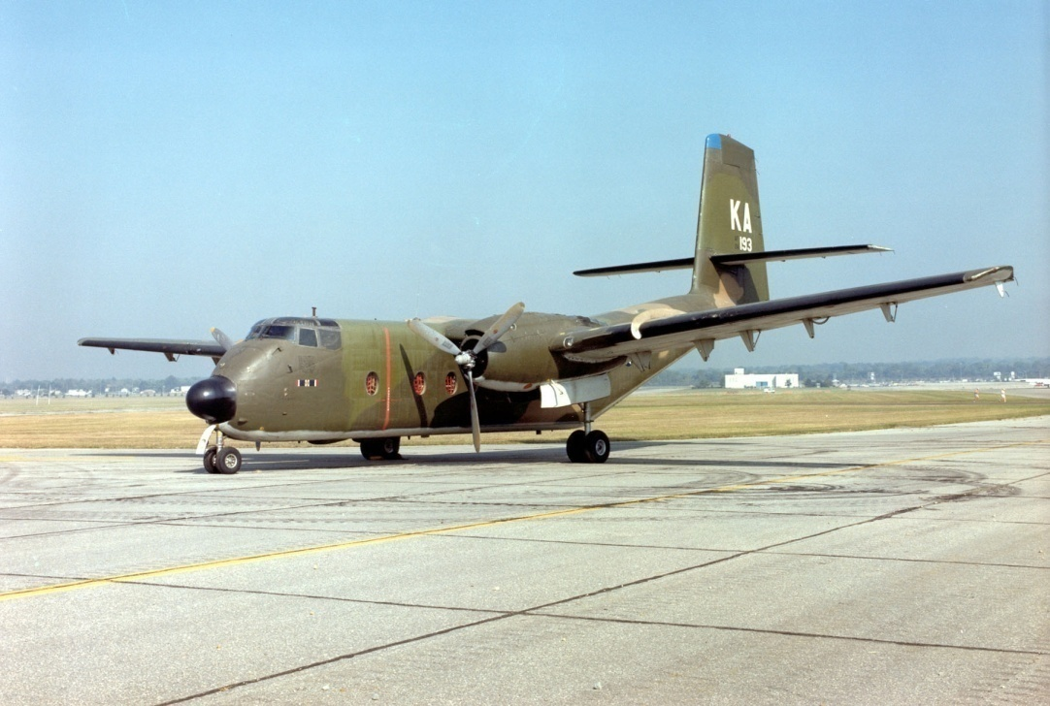

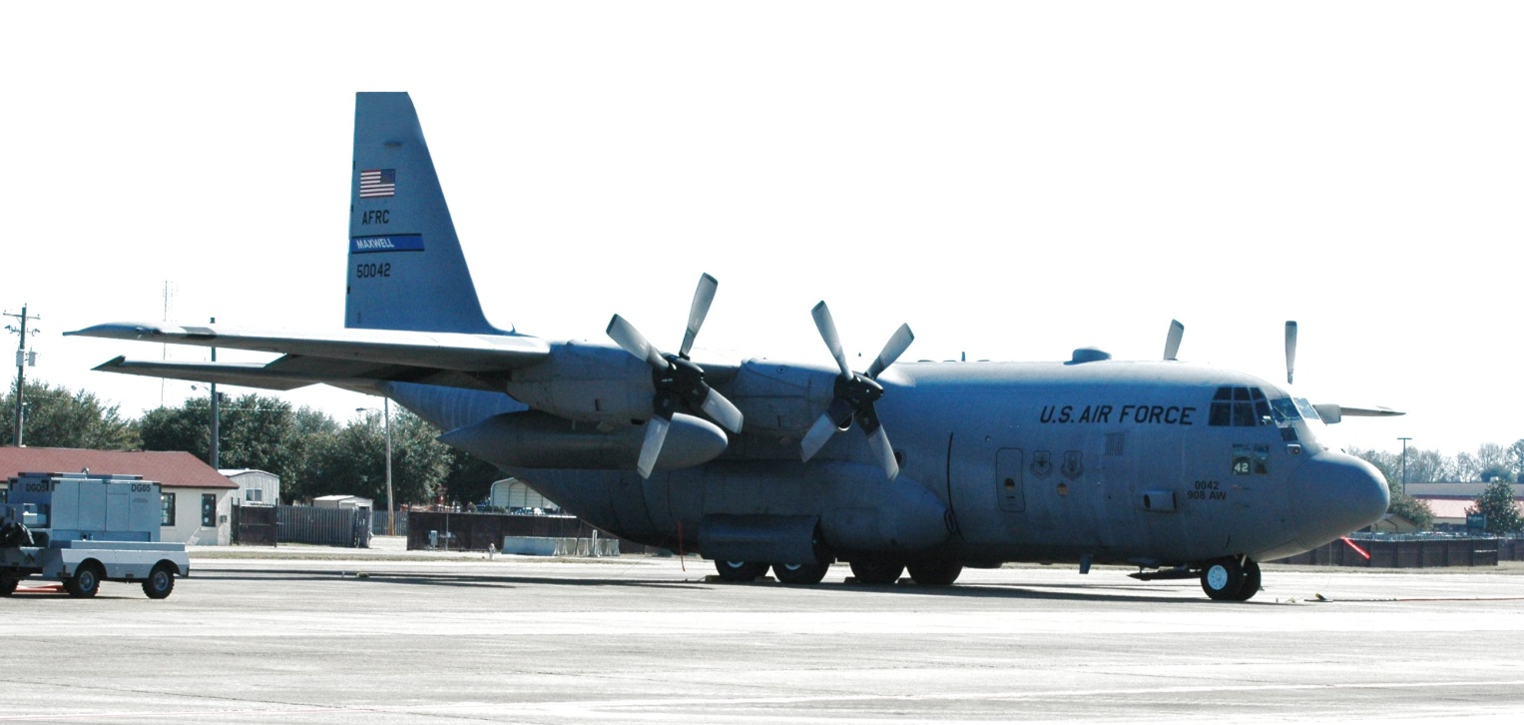
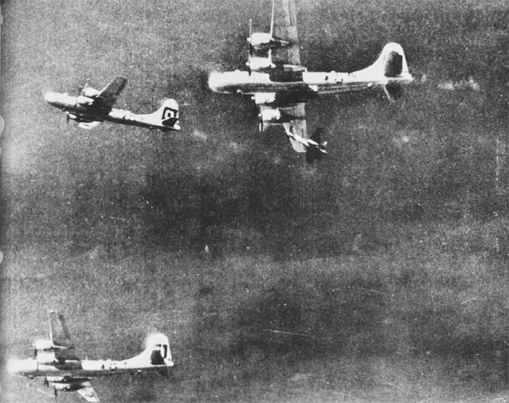
MAFB Heritage, Cont’d
The 908th Airlift Wing has been a
Maxwell resident
since 1969; its
357th Airlift Sqdn
flew B-29s in WWII.

Slide 23
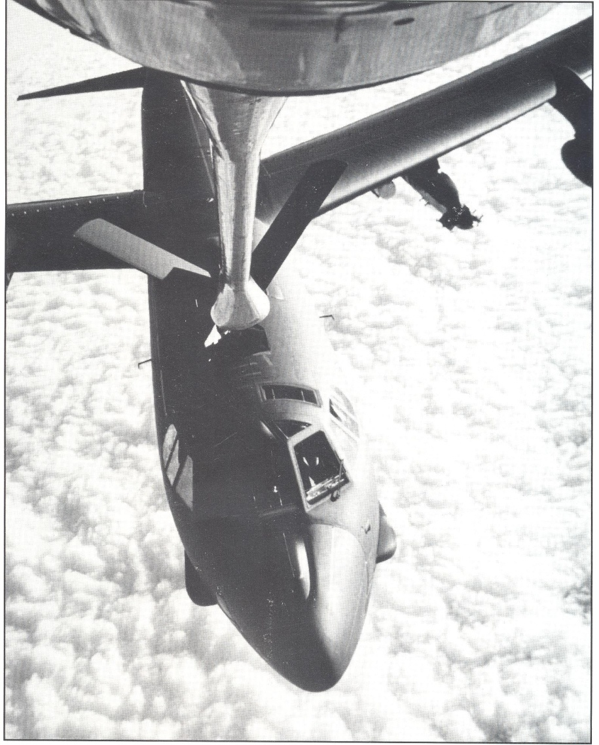

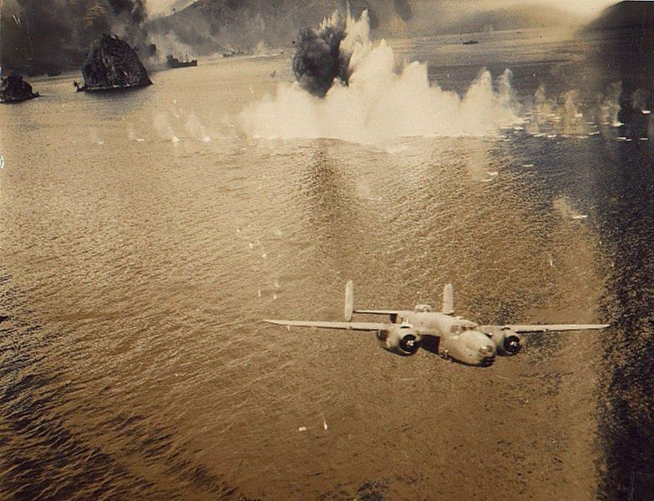
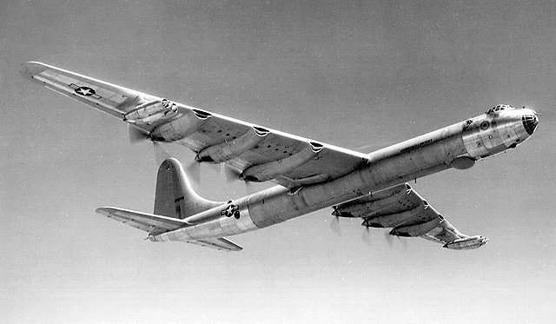
MAFB Heritage, Cont’d
The 42nd ABW came to Maxwell in 1994.
As a WWII Bomb Group, it fought in the Pacific, and as
a Bomb Wing it kept watch throughout
the Cold War.

Slide 24
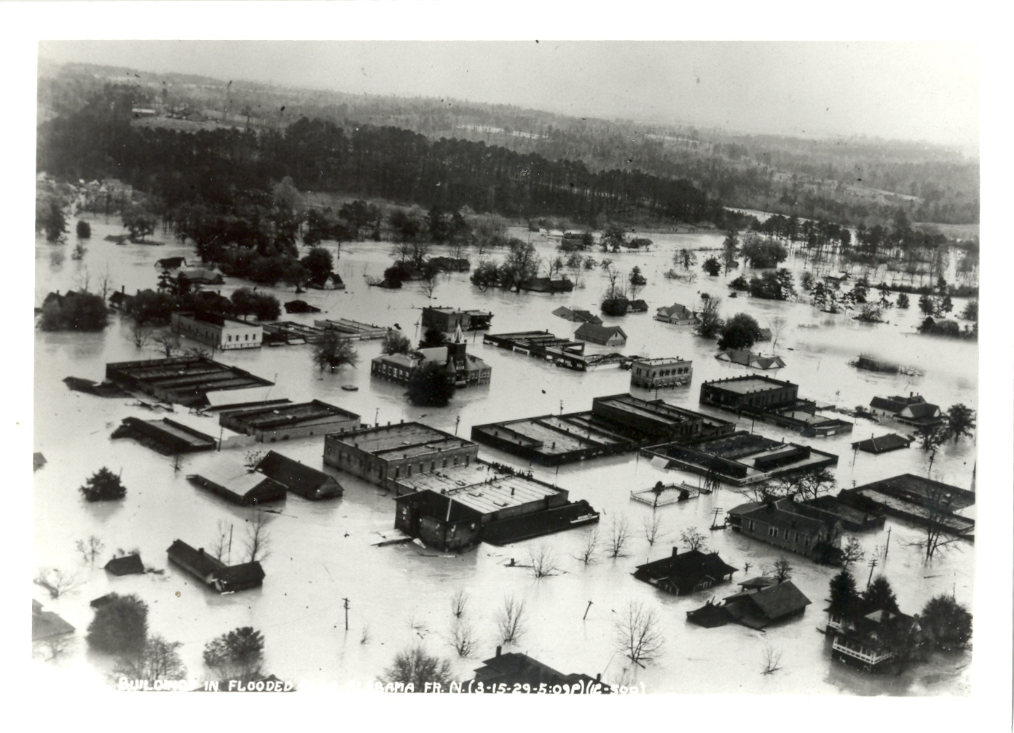
Maxwell Responds
Elba, Alabama 15 Mar 29

Slide 25
Maxwell Personnel flew dawn to dusk air drop missions for 5 days
  40 planes (some coming from as far away as Langley Va.)
  14-20 March Maxwell Pilots
    flew 346 sorties
    Covered approximately 60,000 miles
    First time food and supplies airdropped by US military during a major civilian emergency

Slide 26
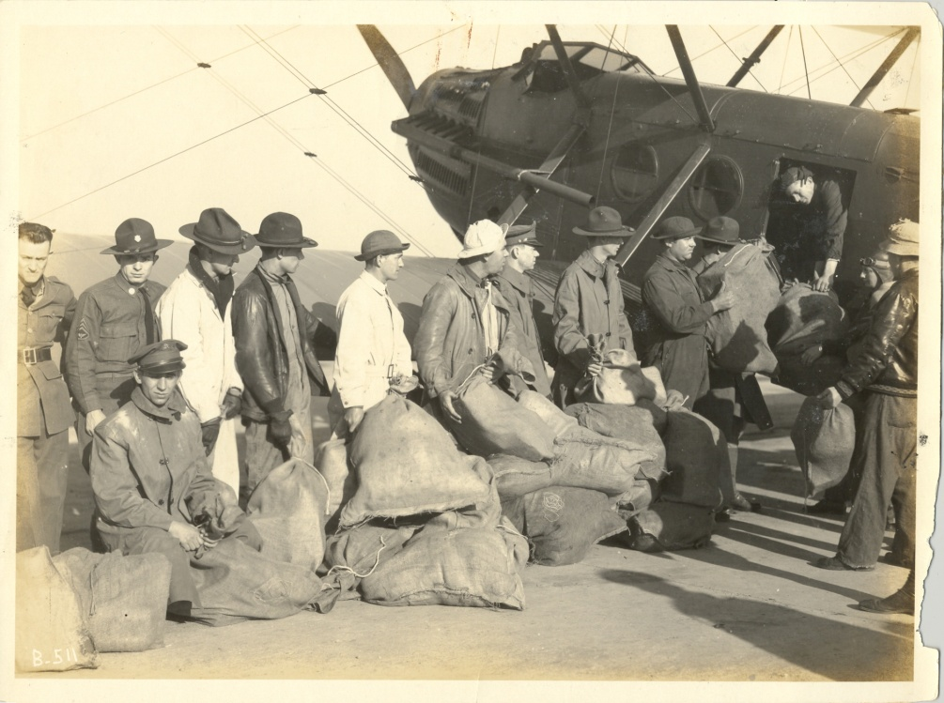
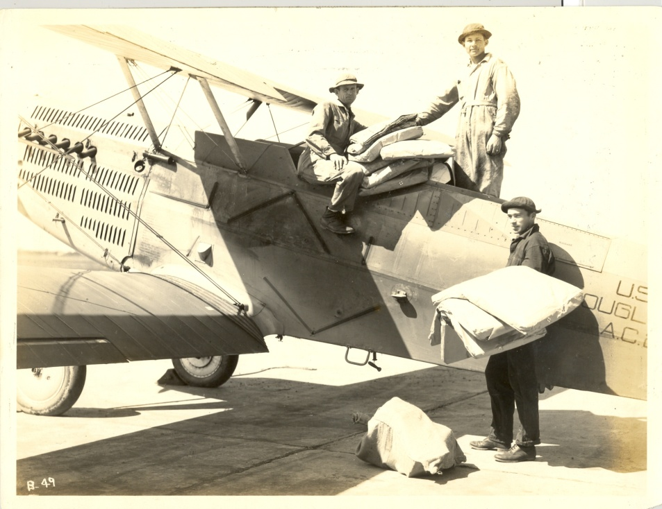

Slide 27
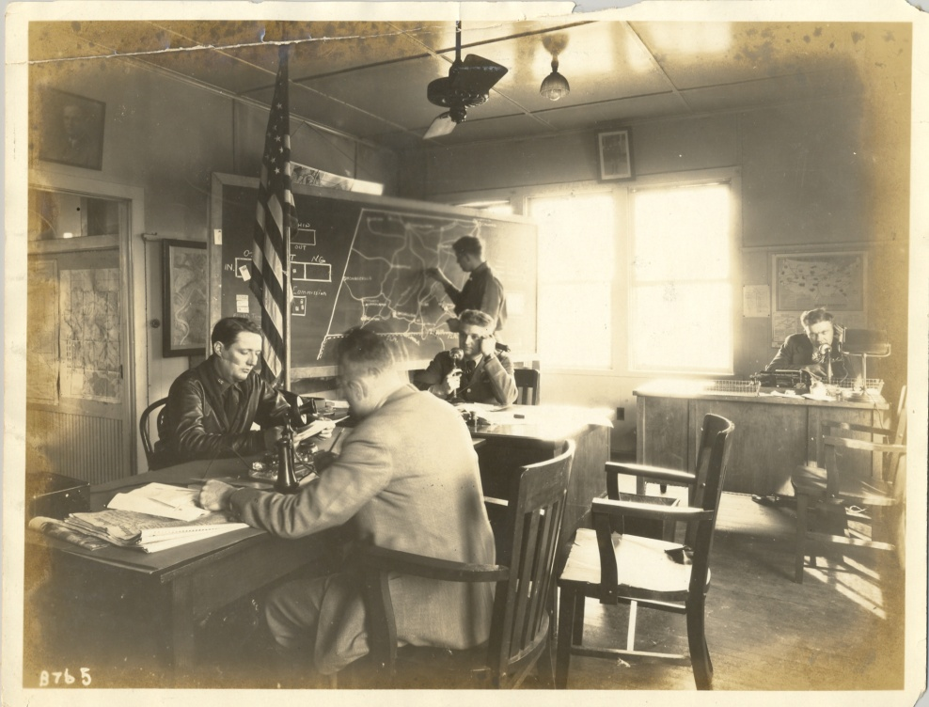
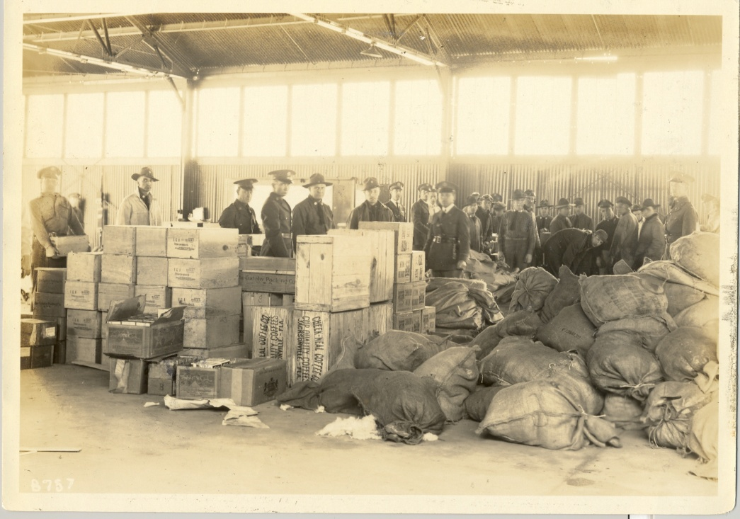
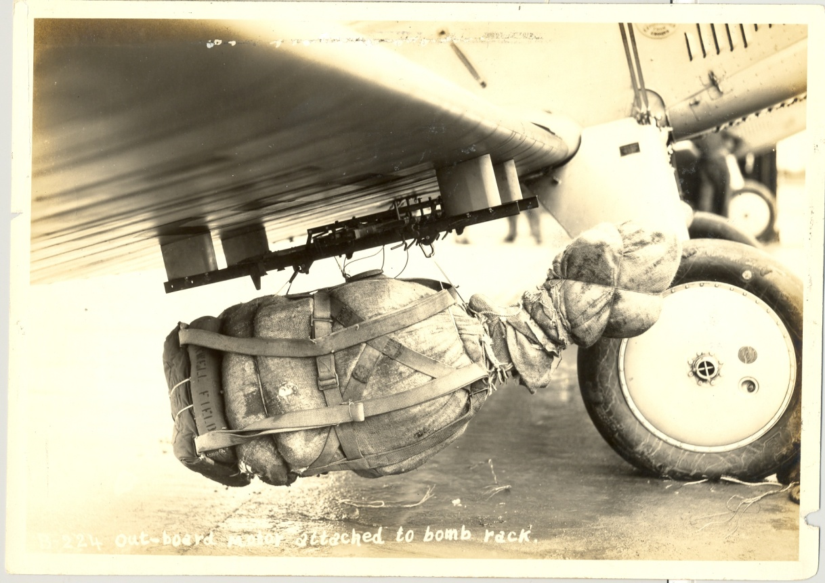
Outboard motor attached to bomb rack

Slide 28
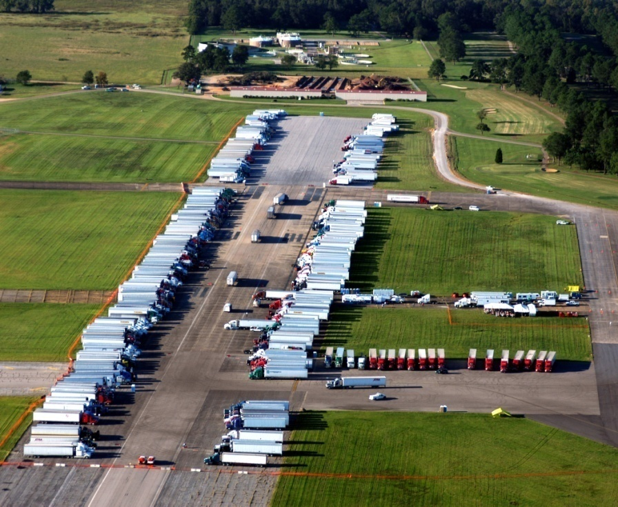
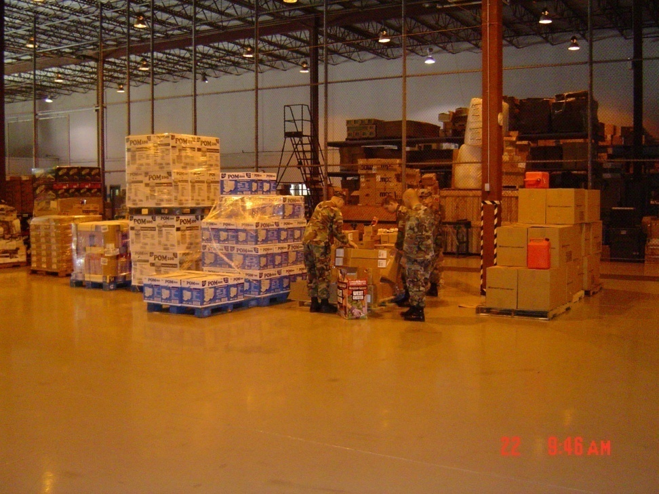
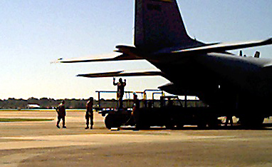
Maxwell continues to respond
Hurricane Ivan

Slide 29
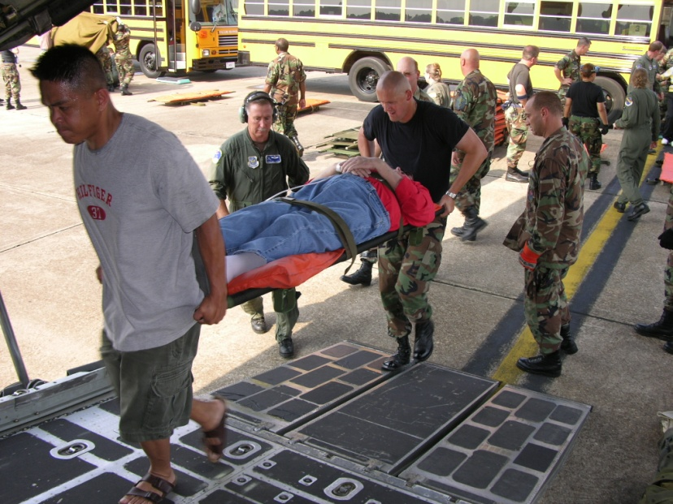



MAFB Heritage, Cont’d
MAFB is a FEMA regional staging
area for disaster prep & relief…
Relief Stores for Hurricane Ivan, 2004
Katrina Evacuees, 2005

Slide 31




Katrina

Slide 32




Katrina

Slide 33
Hurricane Katrina Evacuees
 | Sep 2 0800 | Sep 5 1430
Total | 681 | 979
Active Duty | 167 | 246
Retired | 66 | 77
Reserve | 17 | 21
Army Nat Grd | 2 | 8
Dependents | 385 | 565
Civilians |  | 44
FEMA | 54 | 54
Army COE | 16 | 15
Pets | 58 | 70
Source: CAT Briefings, 42 ABW, “Hurricane Katrina,” 3-5 Sep 05.

Slide 34

Haiti

Slide 35


MAFB Heritage, Cont’d
But stay alert. Be ready -- natural disasters aren’t
just a coastal problem…
Prattville, 2008

Slide 36


MAFB Heritage, Cont’d
MAFB has always been the Intellectual and
Leadership Center of the
United States Air Force…
…Welcome to the Maxwell-Gunter team!

